Slide 1

Chapter 5
IPv4 Addresses
Copyright © The McGraw-Hill Companies, Inc. Permission required for reproduction or display.

Slide 2
OBJECTIVES:
To introduce the concept of an address space in general and the address space of IPv4 in particular.
To discuss the classful architecture and the blocks of addresses available in each class.
To discuss the idea of hierarchical addressing and how it has been implemented in classful addressing.
To explain subnetting and supernetting for classful architecture.
To discuss classless addressing, that has been devised to solve the problems in classful addressing.
To discuss some special blocks and some special addresses in each block.
To discuss NAT technology and show how it can be used to alleviate of address depletion.

Slide 3
Chapter Outline
5.1 Introduction
5.2 Classful Addressing
5.3 Classless Addressing
5.4 Special Addresses
5.5 NAT

Slide 4
5-1 INTRODUCTION
The identifier used in the IP layer of the TCP/IP protocol suite to identify each device connected to the Internet is called the Internet address or IP address. An IPv4 address is a 32-bit address that uniquely and universally defines the connection of a host or a router to the Internet; an IP address is the address of the interface.

Slide 5
Topics Discussed in the Section
Notation
Range of Addresses
Operations

Slide 6

Note
An IPv4 address is 32 bits long.
Note
The IPv4 addresses are unique and universal.

Slide 7
Note
The address space of IPv4 is 2³² or 4,294,967,296.
more than four billion
Note
Numbers in base 2, 16, and 256 are discussed in Book at Appendix B.

Slide 8
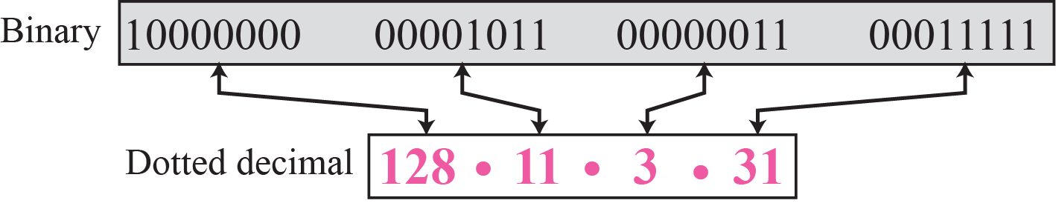
Figure 5.1 Dotted-decimal notation
IP addresses can be thought of as a number written with 256 base
Notes:
IP address can be thought of as a number written with 256 base

Slide 9
IP addresses as 256 base Address
10 base(Decimal) Number System(0-9) |  | 256 Base Number System(0-255)
Position |  | Position
10⁰ | 0000…0009 | 256⁰ | 0.0.0.0 to 0.0.0.255
10¹ | 0010…0019...0099 | 256¹ | 0.0.1.0 …. 0.0.1.255, 0.0.255.0,… , 0.0.255.225
10² | 0100,…..0999 | 256² | 0.1.0.0, …,0.1.0.255, 0.1.1.0,…,0.1.255.255,… 0.255.0.0,…, 0.255.255.255
10³ | 1000,….9999 | 256³ | 1.0.0.0,..,1.0.0.255, 1.0.1.0,.., 1.0.1.255,…, 1.0.255.0,…, 1.0.255.255, ………………………….. 255.255.255.255
128.11.3.31 =
128*256³ +11*256²+3*256¹+31*256⁰ =2,147,483,648+720,896+768+31
= 2,148,205,343
We can do 256 base addition, subtraction operations on IP addresses
Notes:
We can do 256 base addition, subtraction operations on IP addresses

Slide 10
Example 5.1
Change the following IPv4 addresses from binary notation to dotted-decimal notation.
a. 10000001 00001011 00001011 11101111
b. 11000001 10000011 00011011 11111111
c. 11100111 11011011 10001011 01101111
d. 11111001 10011011 11111011 00001111
Solution
We replace each group of 8 bits with its equivalent decimal number (see Appendix B) and add dots for separation:
a. 129.11.11.239
b. 193.131.27.255
c. 231.219.139.111
d. 249.155.251.15
Notes:
Dotted Decinal Notation & Binary Notation

Slide 11
Example 5.2
Change the following IPv4 addresses from dotted-decimal notation to binary notation.
a. 111.56.45.78
b. 221.34.7.82
c. 241.8.56.12
d. 75.45.34.78
Solution
We replace each decimal number with its binary equivalent:
a. 01101111 00111000 00101101 01001110
b. 11011101 00100010 00000111 01010010
c. 11110001 00001000 00111000 00001100
d. 01001011 00101101 00100010 01001110

Slide 12
Example 5.3
Find the error, if any, in the following IPv4 addresses:
a. 111.56.045.78
b. 221.34.7.8.20
c. 75.45.301.14
d. 11100010.23.14.67
Solution
a. There should be no leading zeroes (045).
b. We may not have more than 4 bytes in an IPv4 address.
c. Each byte (301) should be less than or equal to 255.
d. A mixture of binary notation and dotted-decimal notation.
Notes:
Find Mistakes in the IP Representation

Slide 13
Example 5.4
Change the following IPv4 addresses from binary notation to hexadecimal notation.
a. 10000001 00001011 00001011 11101111
b. 11000001 10000011 00011011 11111111
Solution
We replace each group of 4 bits with its hexadecimal equivalent. Note that 0X (or 0x) is added at the beginning or the subscript 16 at the end.
a. 0X810B0BEF or 810B0BEF₁₆
b. 0XC1831BFF or C1831BFF₁₆
Notes:
Binary Notation and Equivalent Hexa-Decimal Notations –using 0x OR subscript 16

Slide 14
Example 5.5
Find the number of addresses in a range if the first address is 146.102.29.0 and the last address is 146.102.32.255.
Solution :
We can subtract the first address from the last address in base 256 (see Appendix B). The result is 0.0.3.255 in this base.
To find the number of addresses in the range (in decimal), we convert this number to base 10 and add 1 to the result..
146.102.32.255
- 146.102.29.0
=============
0.0.3.255
Notes:
Using 256 Number System, Find number of Addresses
0.0.3.255 can be thought of as (0.0.0.0 to 0.0.3.255 ) 4 groups each containing 256(0 to 255) address groups – 0.0.0. to 0.0.0.255 means 256 addresses ; 0.0.1.0 to to 0.0.1.255 means 256 ; 0.0.2.0 to 0.0.2.255 means 256; 0.0.3.0 to 0.0.3.255 256 addresses
Another way is
146.102.29.0 to 146.102.29.255 is 256 addresses
146.102.30.0 to 146.102.30.255 is 256 addresses
146.102.31.0 to 146.102.31.255 is 256 addresses
146.102.32.0 to 146.102.32.255 is 256 addresses
So totally 256+256+256+256=1024 addresses
Consider example using decimal values – If starting number is 10 and last values is 15 then how many values are in the range 10,11,12,13,14,15 ( 6 values are there in the range 10 to 15) i.e 15-10+1=6

Slide 15
Example 5.6
The first address in a range of addresses is 14.11.45.96. If the number of addresses in the range is 32, what is the last address?
Solution
We convert the number of addresses (32) minus 1 (i.e. 31) to base 256, which is 0.0.0.31. We then add it to the first address to get the last address. Addition is in base 256.
Notes:
If number of Addresses in the range is 159, 160,161 , what is last Addresses.
Given 1st Address ,adding 32 Addresses and finding the Last address .
Adding 32 addresses means 0.0.0.0 to 0.0.0.31
Consider example using decimal values – If starting number is 10 and there are 5 values in the range means -10,11,12,13,14 (means 10+(5-1)=14 is last number)

Slide 16
Example
The first address in a range of addresses is 14.11.45.96. If the number of addresses in the range is 160, 161 and 162 , what is the last address in each case?
Solution
We convert the number of addresses(160) minus 1 (i.e. 159) to base 256, which is 0.0.0.159. We then add it to the first address to get the last address. Addition is in base 256.
14.11.45.96
+ 0. 0. 0.159
=============
14.11.45.255
14.11.45.96
+ 0. 0. 0.160
=============
14.11.46.0
14.11.45.96
+ 0. 0. 0.161
=============
14.11.46.1
Notes:
If number of Addresses in the range is 159, 160,161 , what is last Addresses.
Given 1st Address ,adding 32 Addresses and finding the Last address .
Adding 32 addresses means 0.0.0.0 to 0.0.0.31
1st address 14.11.45.96 , find last address if 300 addresses are in the range
300 means 300-1=299 , 299 converted to 256 base number i.e. 299/256 gives 1 quotient and 43 remainder
Therefore 299 means 0.0.1.43 (means 0.0.0.0 to 0.0.0.255 total 256 addresses ,0.0.1.0 to 0.0.1.43 means total 44 addresses
Therefore total addresses from 0.0.0.0 to 0.0.1.43 is 256+44=300 addresses.)
Last address can be calculated as-
14.11.45.96
+ 0. 0. 1. 43
==========
14. 11. 46.139

Slide 17
Example
The first address in a range of addresses is 14.11.45.96. If the number of addresses in the range is 300, 420 what is the last address in each case?
Solution
We convert the number of addresses(300) minus 1 (i.e. 299) to base 256, which is 0.0.1.43 We then add it to the first address to get the last address. Addition is in base 256.
14.11.45.96
+ 0. 0. 1.43
=============
14.11.46.139
14.11.45.96
+ 0. 0. 1.163
======1======= 14.11.47.3
Notes:
If number of Addresses in the range is 159, 160,161 , what is last Addresses.
Given 1st Address ,adding 32 Addresses and finding the Last address .
Adding 32 addresses means 0.0.0.0 to 0.0.0.31
1st address 14.11.45.96 , find last address if 300 addresses are in the range
300 means 300-1=299 , 299 converted to 256 base number i.e. 299/256 gives 1 quotient and 43 remainder
Therefore 299 means 0.0.1.43 (means 0.0.0.0 to 0.0.0.255 total 256 addresses ,0.0.1.0 to 0.0.1.43 means total 44 addresses
Therefore total addresses from 0.0.0.0 to 0.0.1.43 is 256+44=300 addresses.)
Last address can be calculated as-
14.11.45.96
+ 0. 0. 1. 43
==========
14. 11. 46.139
Example 2:
1st address 14.11.45.96 , find last address if 420 addresses are in the range
420 means 420-1=419 , 419 converted to 256 base number i.e. 419/256 gives 1 quotient and 163 remainder
Therefore 419 means 0.0.1.163
14.11.45.96
+ 0. 0. 1.163
======1=======
14.11.47.3 96+163 gives 259 which exceeds 255 therefore 1 carry and 3 (i.e. 259-256 =3 )

Slide 18
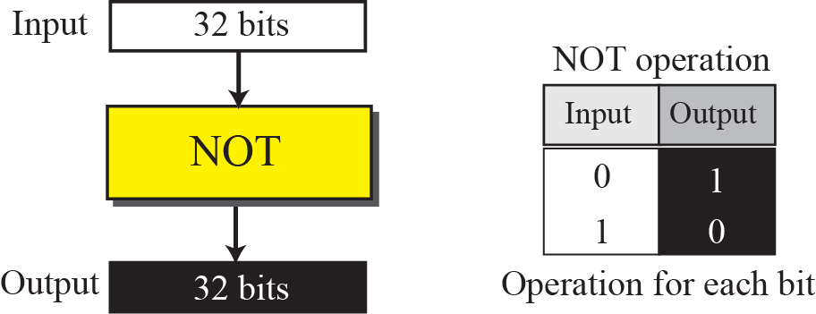
Figure 5.2 Bitwise NOT operation
Notes:
256 base complement of a given number n₂₅₆ is done by subtracting n from 255.
Example : Complement of an IP (which is 256 base number) 190.70.80.10 is 255.255.255.255 - 190.70.80.10 = 65.185. 175.245
i.e Complement of(190.70.80.10) = 65.185. 175.245

Slide 19
Example 5.7
256 base Complement Operation
Complement of 17₂₅₆ =255₂₅₆ -17₂₅₆ =238₂₅₆
Subtracting a given number from 255 gives the 256 base complement of given number
Notes:
256 base Complement Operation
Complement of 17₂₅₆ =255₂₅₆ -17₂₅₆ =238₂₅₆
Subtracting a given number from 255 gives the 256base complement of given number

Slide 20
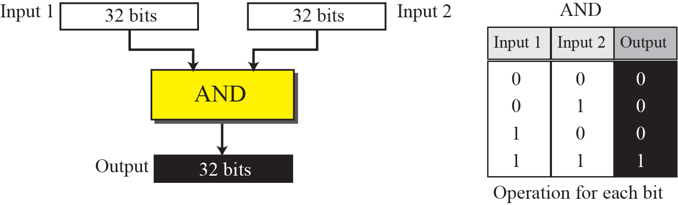
Figure 5.3 Bitwise AND operation
256 base AND Operation
Use two short cuts.
When at least one of the numbers is 0 or 255, the AND operation selects the
smaller byte (or one of them if equal).
0 AND X=0 & 255 AND X=X , where X<=255
2. When none of the two bytes is either 0 or 255, we can write each byte as the
sum of eight terms, where each term is a power of 2.
We then select the smaller term in each pair (or one of them if equal) and add them to get the result.
Notes:
256 base AND Operation

Slide 21
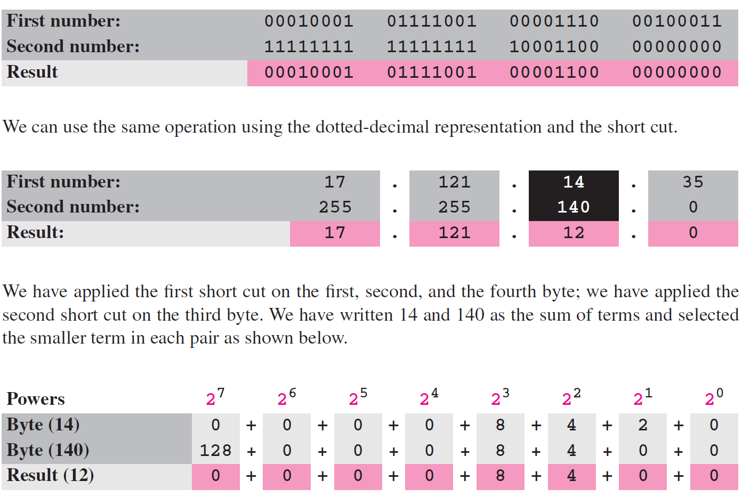
Example 5.8
256 base AND Operation
2⁷ 2⁶ 2⁵ 2⁴ 2³ 2² 2¹ 2⁰
0 0 0 0 1 1 1 0 =14₍₁₀₎
select the smaller term in each pair (or one of them if equal) and add them to get the result
Notes:
two numbers, when the numbers are represented in dotted-decimal notation, we
can use two short cuts.
1. When at least one of the numbers is 0 or 255, the AND operation selects the
smaller byte (or one of them if equal).
2. When none of the two bytes is either 0 or 255, we can write each byte as the sum
of eight terms, where each term is a power of 2. We then select the smaller term in
each pair (or one of them if equal) and add them to get the result.

Slide 22
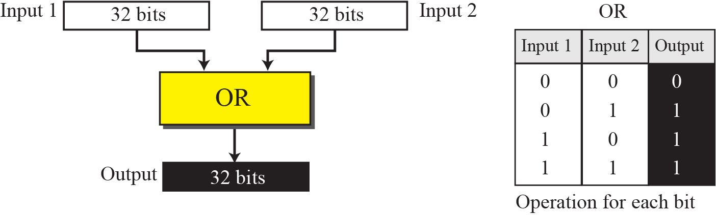
Figure 5.4 Bitwise OR operation
256 base OR Operation
Use two short cuts.
1. When at least one of the two bytes is 0 or 255, the OR operation selects the larger byte (or one of them if equal).
2. When none of the two bytes is 0 or 255, we can write each byte as the sum of eight terms, where each term is a power of 2. We then select the larger term in each pair (or one of them if equal) and add them to get the result of OR operation.

Slide 23
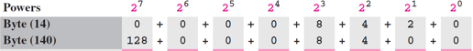
Example 5.9
256 base OR Operation
OR
128 | 0 | 0 | 0 | 8 | 4 | 2 | 0
=142
select the larger term in each pair (or one of them if equal) and add them to get the result

Slide 24
5-2 CLASSFUL ADDRESSING
IP addresses, when started a few decades ago, used the concept of classes. This architecture is called classful addressing. In the mid-1990s, a new architecture, called classless addressing, was introduced that supersedes the original architecture. In this section, we introduce classful addressing because it paves the way for understanding classless addressing and justifies the rationale for moving to the new architecture. Classless addressing is discussed in the next section.
Notes:
Initially Classful addressing is introduced, because of short comes in classful address classless addressing is introduced in mid 1990’s.
Classless took over the classful address.
Classful helps in understanding classful and Classless is more general because classful is a special case of Classless.

Slide 25
Topics Discussed in the Section
Classes
Classes and Blocks
Two-Level Addressing
Three-Level Addressing: Subnetting
Supernetting

Slide 26
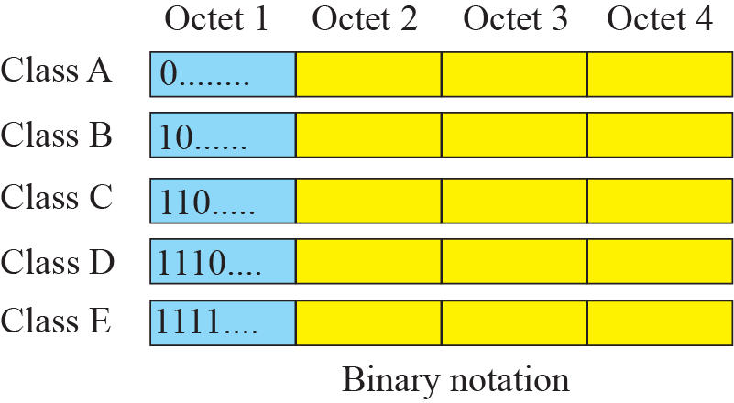
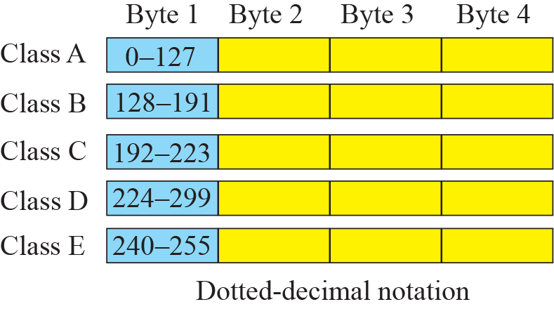
Figure 5.6 Finding the class of address
239
First Octet value range for Classes
Class | Staring Bits | Lower Bound | Upper Bound | Lower Bound | Upper Bound
A | 0… | 00000000 | 01111111 | 0 | 127
B | 10… | 10000000 | 10111111 | 128 | 191
C | 110.. | 11000000 | 11011111 | 192 | 223
D | 1110.. | 11100000 | 11101111 | 224 | 239
E | 1111… | 11110000 | 11111111 | 240 | 255
Notes:
First Octet value range for Classes
Identify the address class of the following IP addresses: 200.58.20.165; 128.167.23.20; 16.196.128.50;
50.156.10.10; 250.10.24.96.
Remember 1st range 0-127 ,
Number of address in class A 128 addresses
Number of address in class B 64 address range 128 to 127+64 i.e. 128 to 191
Number of address in class C 32 address range 192 to 191+32 i.e. 192 to 223
Number of address in class D 16 address range 224 to 223+16 i.e. 192 to 239
Similarly in Class E same as Class D

Slide 27
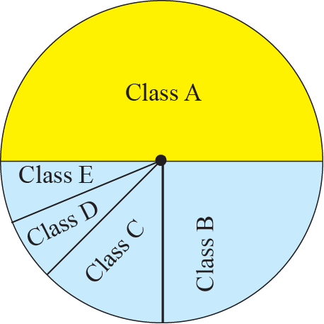
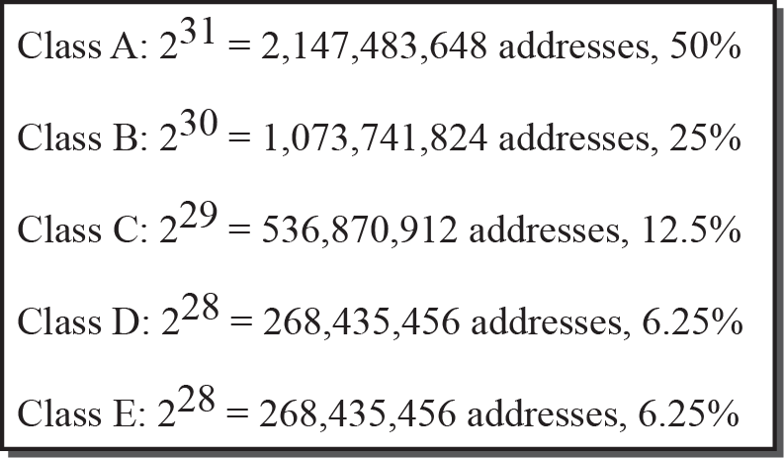
Figure 5.5 Occupation of address space
The address space of IPv4 is 2³² or 4,294,967,296.
Total possible addresses in IPv4 =2
Class | Starting Bits fixed | Remaining Bits | Possible Number of Addresses
A | 0… | 32-1=31 | 2³¹= 2³²⁻¹=2³²/2¹ | half(50%) of 2³²
B | 10… | 32-2=30 | 2³⁰= 2³²⁻²=2³²/2² | 1/4th(25%) of 2³²
C | 110.. | 32-3=29 | 2²⁹= 2³²⁻³=2³²/2³ | 1/8th(12.5%) of 2³²
D | 1110.. | 32-4=28 | 2²⁸= 2³²⁻⁴=2³²/2⁴ | 1/16th(6.25%) of 2³²
E | 1111… | 32-4=28 | 2³¹= 2³²⁻⁴=2³²/2⁵ | 1/16th(6.25%) of 2³²
Notes:
Class a ,1st bit is fixed to 0, o remaining 31 bits can be used to form all addresses in Class-A. Therefore a total addresses in Class A is 2³¹. 2³¹=2³²⁻¹ =2³² /2¹ means half (i.e. 50%) of total address space( 2³²)
Class A 0.0.0.0 to 0.255.255.255 256 *256*256 addresses
1.0.0.0 to 1. 255.255.255 256 *256*256 addresses
2.0.0.0 to 2.255.255.255 256 *256*256 addresses
………… to ……………………… …………………………………….
127.0.0.0 to 127.255.255.255 256 *256*256 addresses
0 to 127 means 128 group, each group containing 256*256*256 addresses
128*256*256*256=2147483648 total addresses in Class-A
(other way is In class A , 1st bit fixed to 0 , therefore only remaining 31 bits form addresses ,so 2³¹ =2147483648)
Similarly class B 192 to 128 means 64 groups and each group containing 256*256*256 addresses.
64*256*256*256 = 1073741824 i.e. half of class-A addresses
i.e. 128.0.0.0 to 128.255.255.255
129.0.0.0 to 129.255.255.255
………………..to ……………..
192.0.0.0 to 192.255.255.255
(other way is In class B , 1st two bits fixed to 10 , therefore only remaining 30 bits form addresses ,so 2³⁰ =1073741824

Slide 28
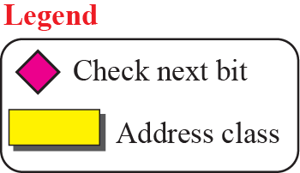
Figure 5.7 Finding the class of an address using continuous checking
Class: A Starts with 0
Class: B Starts with 10
Class: C Starts with 110
Class: D Starts with 1110
Class: E Starts with 1111
Notes:
Class: A Starts 0
Class: B Starts 10
Class: C Starts 110
Class: D Starts 1110
Class: E Starts 1111
Computers often store IPv4 addresses in binary notation. In this case, it is very
convenient to write an algorithm to use a continuous checking process for finding the
address as shown in Figure 5.7.

Slide 29
Example 5.10
Find the class of each address:
a. 00000001 00001011 00001011 11101111
b. 11000001 10000011 00011011 11111111
c. 10100111 11011011 10001011 01101111
d. 11110011 10011011 11111011 00001111
Solution
See the procedure in Figure 5.7.
a. The first bit is 0. This is a class A address.
b. The first 2 bits are 1; the third bit is 0. This is a class C address.
c. The first bit is 1; the second bit is 0. This is a class B address.
d. The first 4 bits are 1s. This is a class E address.

Slide 30
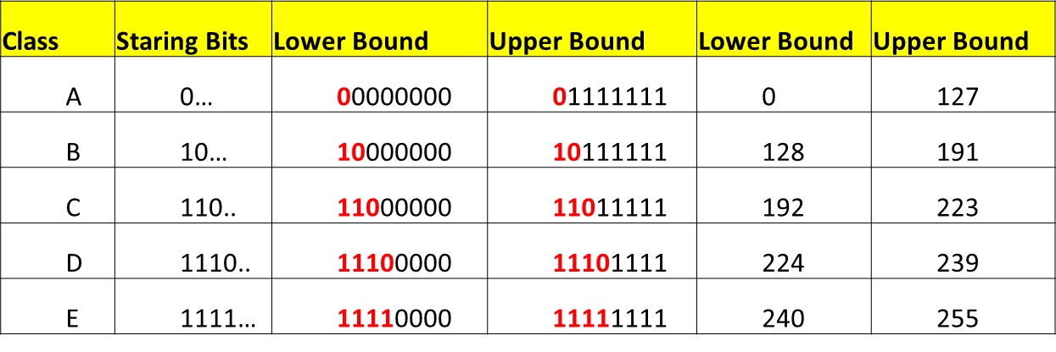
Example 5.11
Find the class of each address:
a. 227.12.14.87
b. 193.14.56.22
c. 14.23.120.8
d. 252.5.15.111
Solution
a. The first byte is 227 (between 224 and 239); the class is D.
b. The first byte is 193 (between 192 and 223); the class is C.
c. The first byte is 14 (between 0 and 127); the class is A.
d. The first byte is 252 (between 240 and 255); the class is E.
First Octet value range for Classes

Slide 31
Figure 5.8 Netid and hostid
IP address in classes A, B, and C is divided into netid and hostid
Notes:
In classful addressing, an IP address in classes A, B, and C is divided into netid and hostid.
These parts are of varying lengths, depending on the class of the address. Figure 5.8
shows the netid and hostid bytes. Note that classes D and E are not divided into netid
and hostid

Slide 32
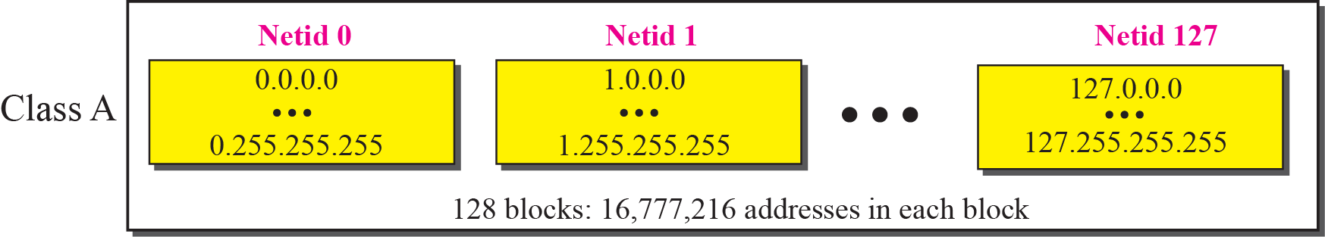
Figure 5.9 Blocks in Class A
One problem with classful addressing is that each class is divided into a fixed number of blocks with each block having a fixed size.
Each of 128 blocks are containing large number of addresses.
Means every netid has large number of hostids (IPs for hosts) which is very large for any network. So many go waste.
Notes:
Class A
Since only 1 byte in class A defines the netid and the leftmost bit should be 0, the next
7 bits can be changed to find the number of blocks in this class. Therefore, class A is
divided into 2⁷ = 128 blocks that can be assigned to 128 organizations (the number is
less because some blocks were reserved as special blocks). However, each block in this
class contains 16,777,216 addresses.
Each of 128 blocks are containing alrge number of addresses

Slide 33
Note
Millions of class A addresses are wasted.

Slide 34
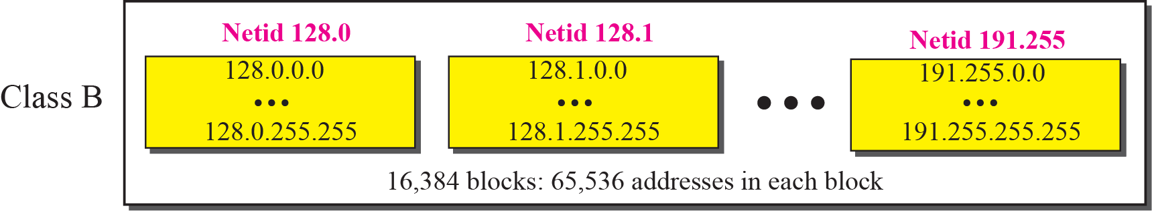
Figure 5.10 Blocks in Class B
1st Octet value range for Classes
Net ids’s 2 bytes(16 bits),
Leftmost 2 bits fixed 10
16-2=14 bits for netids
2¹⁴= 16384 networks
Notes:
Class B
Since 2 bytes in class B define the class and the two leftmost bit should be 10 (fixed),
the next 14 bits can be changed to find the number of blocks in this class. Therefore,
class B is divided into 2¹⁴ = 16,384 blocks that can be assigned to 16,384 organizations
(the number is less because some blocks were reserved as special blocks). However,
each block in this class contains 65,536 addresses. Not so many organizations can use
so many addresses. Many addresses are wasted in this class.
Another way – 128.0.0.0 to 128.0.255.255 (one Block) with 256 address
128.1.0.0 to 128.1.255.255 (2nd Block) with 256 address
so on
128.255.0.0 to 128.255.255.255 (256 th block) with 256 address
Similarly 129.0.0.0 to 129.0.255.255 (one Block) with 256 address
so on
129.255.0.0 to 129.255.255.255 (256 th block) with 256 address
So On …
191.0.0.0 to 191.0.255.255 (one Block) with 256 address
so on
191.255.0.0 to 191.255.255.255 (256 th block) with 256 address
191-128+63+1=64 groups each constraining 256 blocks
Therefore Total blocks are 64*256=16,384 blocks(net ids) each with 256*256 =65536 address
An organization has an IP address 150.32.64.34 .What is the range of IP addresses that a host can have ?

Slide 35
Note
Many class B addresses are wasted.

Slide 36
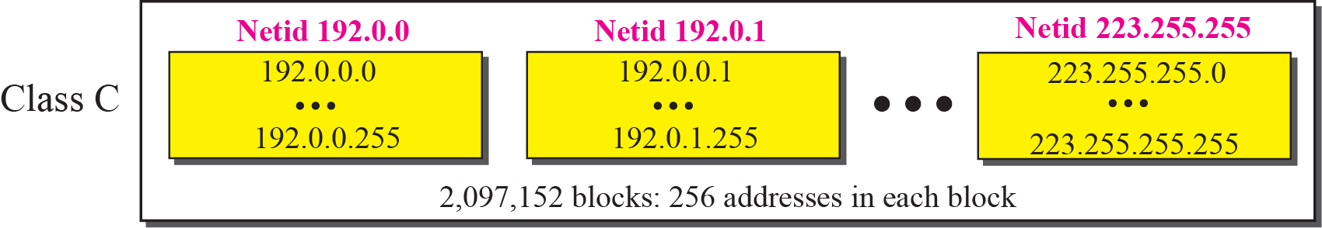
Figure 5.11 Blocks in Class C
1st Octet value range for Classes
Net ids’s 3 bytes(24 bits),
Leftmost 3 bits fixed 110
24-3=21 bits for netids
2²¹= 20,97,152 networks
Notes:
Class C
Since 3 bytes(24 bits) in class C define the class and the THREE leftmost bit should be 110 (fixed),
the next 24-3=21 bits can be changed to find the number of blocks in this class. Therefore,
class B is divided into 2²¹ = 20,97,152 blocks and each block can be assigned to 20,97,152 organizations
(the number is less because some blocks were reserved as special blocks). However,
each block in this class contains 256 addresses. 256 addresses for each organizations is small.

Slide 37
Note
Not so many organizations are so small to have a class C block.

Slide 38
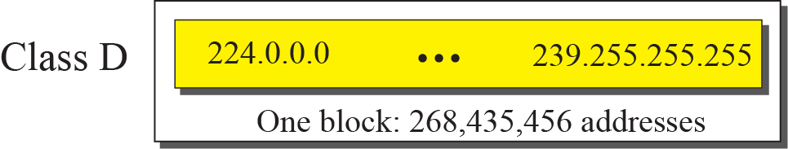
Figure 5.12 The single block in Class D
1st Octet value range for Classes
One single block
Leftmost 4 bits fixed 1110
32-4=28 bits for addresses
2²⁸= 26,84,35,456 addresses

Slide 39
Note
Class D addresses are made of one block, used for multicasting.

Slide 40
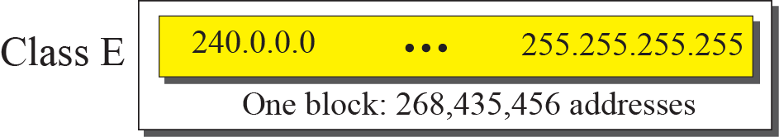
Figure 5.13 The single block in Class E
1st Octet value range for Classes
One single block
Leftmost 4 bits fixed 1111
32-4=28 bits for addresses
2²⁸= 26,84,35,456 addresses
Notes:
0 to 127

Slide 41
Note
The only block of class E addresses was reserved for future purposes.

Slide 42
Note
The range of addresses allocated to an organization in classful addressing
was a block of addresses in
Class A, B, or C.

Slide 43
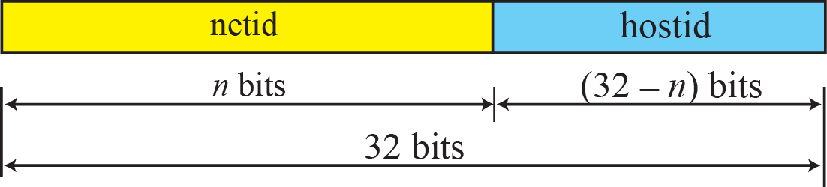
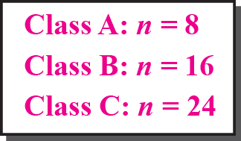
Figure 5.14 Two-level addressing in classful addressing
Net id and Host id Length
Fixed netid’s and host id’s
Notes:
Net id and Host id Length
Fixed netid’s and host id’s

Slide 44
Example 5.12

Slide 45
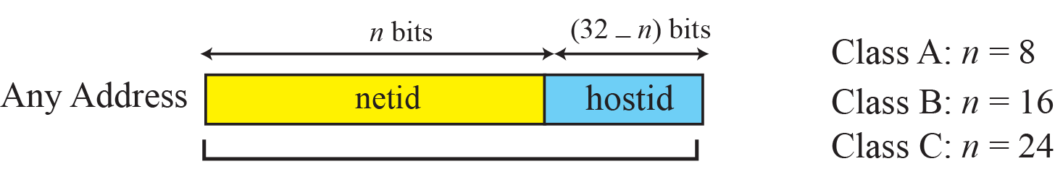
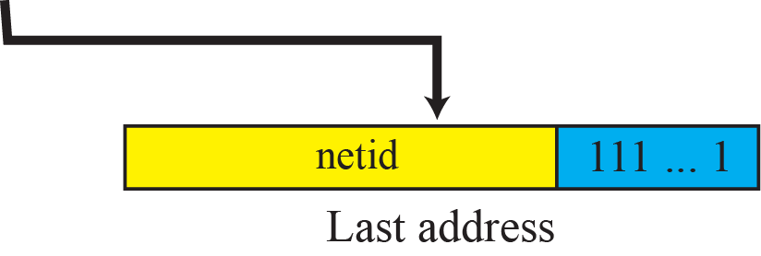
Figure 5.15 Information extraction in classful addressing
Extracting range of addresses from given block of address (of a class)
(number of hosts that can be connected in a network of address class)
Note: In a given block of address, 1st and last addresses are special addresses , not assigned to any host.
Notes:
Note: In a given block of address, 1st and last addresses are special addresses , no assigned to any host
Steps in Extracting Information in a Block
A block is a range of addresses. Given any address in the block, we normally like to
know three pieces of information about the block: the number of addresses, the first address, and the last address.
Assume if a given address is -125.10.50.100
class –A , netid-bits= 8 bits as it is. 32-8=24 bits hostid
Hostids are 24 bits 0’s to 24bits 1’s
125.0.0.0 to 125.255.255.255
We can now find these three pieces of information as shown in Figure 5.15.(See Examples in next Slides)
The number of addresses in the block, N, can be found using N = 232−n.
2. To find the first address, we keep the n leftmost bits and set the (32− n) rightmost bits all to 0s.
3. To find the last address, we keep the n leftmost bits and set the (32− n) rightmost bits all to 1s.

Slide 46
Example 5.13
An address in a block is given as 73.22.17.25. Find the number of addresses in the block, the first address, and the last address.
Solution
Figure 5.16 shows a possible configuration of the network that uses this block. 73.22.17.25 Class A , hence n=8
1. The number of addresses in this block is N = 2^{32−n} =2³²⁻⁸ 16,777,216.
2. To find the first address, we keep the leftmost 8 bits and set the rightmost 24 bits all to 0^{s}. The first address is 73.0.0.0/8, in which 8 is the value of n.
3. To find the last address, we keep the leftmost 8 bits and set the rightmost 24 bits all to 1^{s}. The last address is 73.255.255.255/8.

Slide 47
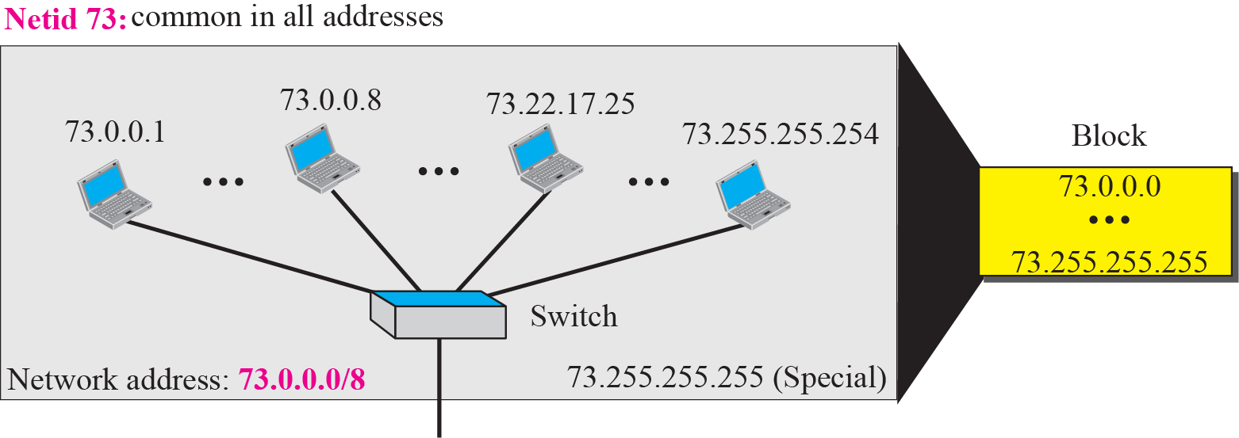
Figure 5.16 Solution to Example 5.13

Slide 48
Example 5.14
An address in a block is given as 180.8.17.9 Find the number of addresses in the block, the first address, and the last address.
Solution
Figure 5.17 shows a possible configuration of the network that uses this block. 180.8.17.9 is Class B, hence n=16
1. The number of addresses in this block is N = 2^{32−n} =2³²⁻¹⁶ = 65,536.
2. To find the first address, we keep the leftmost 16 bits(netid) and set the rightmost 16 bits all to 0s. The first address is 180.8.0.0/16, in which 16 is the value of n.
3. To find the last address, we keep the leftmost 16 bits and set the rightmost 16 bits all to 1s. The last address is 180.8.255.255.

Slide 49
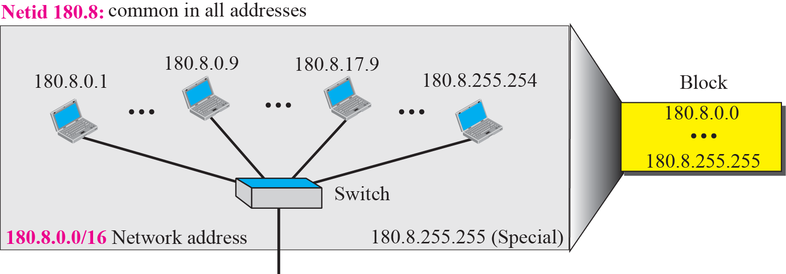
Figure 5.17 Solution to Example 5.14

Slide 50
Example 5.15
An address in a block is given as 200.11.8.45. Find the number of addresses in the block, the first address, and the last address.
Solution
Figure 5.17 shows a possible configuration of the network that uses this block. Class C , so n=24
The number of addresses in this block is N = 2^{32−n} = 256.
2. To find the first address, we keep the leftmost 24 bits and set the rightmost 8 bits all to 0s. The first address is 200.11.8.0/24, in which 24 is the value of n.
3. To find the last address, we keep the leftmost 24 bits and set the rightmost 8 bits all to 1s. The last address is 200.11.8.255/24.

Slide 51
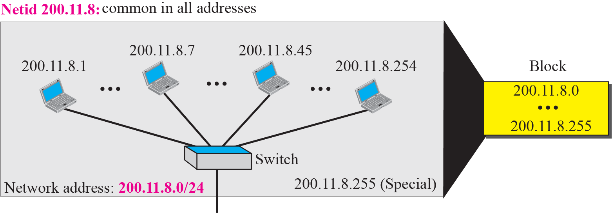
Figure 5.18 Solution to Example 5.15

Slide 52
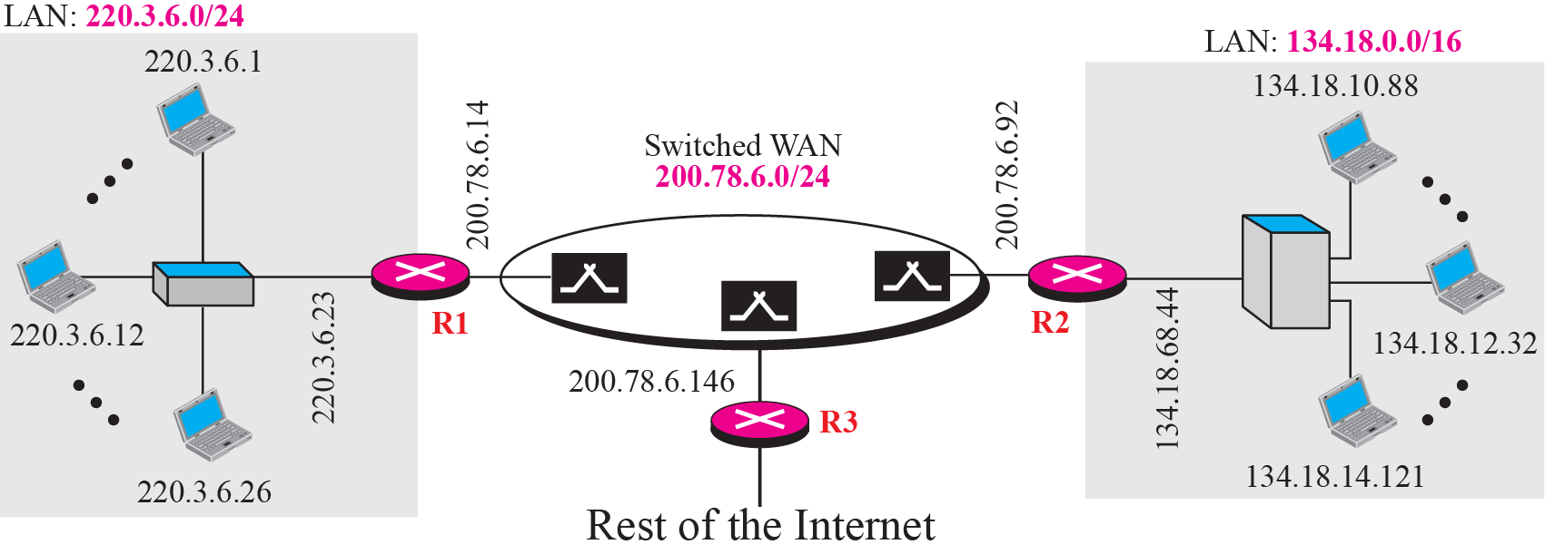
Figure 5.19 Sample Internet
A switched WAN (class C), such as Frame Relay or ATM, that can be connected to many routers.
WAN connects LAN1 ,LAN2 and to the rest of internet.
Notes:
An Example
Figure 5.19 shows a hypothetical part of an internet with three networks.
We have
1. A LAN with the network address 220.3.6.0 (class C).
2. A LAN with the network address 134.18.0.0 (class B).
3. A switched WAN (class C), such as Frame Relay or ATM, that can be connected to
many routers. We have shown three. One router connects the WAN to the left LAN,
one connects the WAN to the right LAN, and one connects the WAN to the rest of
the internet.
India's combined internet speed is 36,000 Gbps!
Where does your Internet service provider get internet from? How does Internet reach India? Let us dive into the world of networking .
More than 99% of the internet traffic relies on high quality fiber optic cables connecting various countries. Only a minuscule part of the traffic goes through satellites
These cable networks are laid and maintained by various governments and giant companies. Such projects are usually undertaken by multiple companies due to the large cost of investment. There are three tiers which differentiates the size of the network held by a company.
Tier-1 :- These are the companies which have a global network connecting so many cables around the world. They will be able to provide access to any destination on the internet without paying fee to others. They usually access the network of other tier-1 companies without paying any fee. This network acts as the backbone of the internet.
Tier-2 :- These are companies which have a regional networks and are usually connected to one or more tier-1 networks. They have to pay a fee to access the tier-1 company's network.
Tier-3 :- These are the Internet Service Providers(ISPs) from whom we buy our broadband connections. They are the last tier, connecting the internet to the end users.
India is connected to the world at Mumbai, Cochin, Chennai and Tuticorine. All of our international internet traffic goes through these port cities. The place where the international cables connect to the land is called landing stations.
Tata Communications owns 3 landing stations in Mumbai, Chennai and Cochin. They are the only Tier-1 company from India.
Bharti Airtel owns 2 landings stations in Chennai and Mumbai.
Reliance Globalcom owns 1 landing station in Mumbai.
Sify Technologies owns 1 landing station in Mumbai
BSNL owns 1 landing station in Tuticorine connecting to Sri Lanka.
On the eastern side, we are connected to Singapore from Chennai. On the western side we are connected to UAE thorough cables from Mumbai. And, on the southern side we are connected to the cables coming from south Africa.
Handing over of traffic from one network to another is called peering. There is a non profit government organization in India called National Internet Exchange of India (NIXI) which allows Indian ISPs to use each others network in an efficient manner rather than using foreign servers. This also increases the quality of service for the consumers and decreases the chances of data being snooped by foreign agencies such as NSA. NIXI created inRegistry in 2005 to start .in domain. (The website names with .in extension.)

Slide 53
Note
The network address is the identifier of a network.

Slide 54
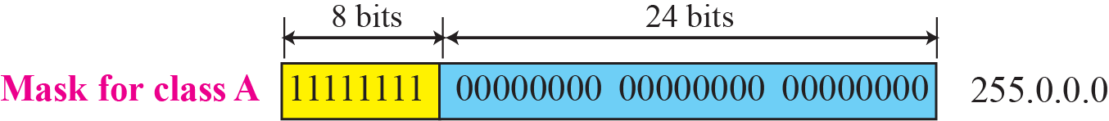
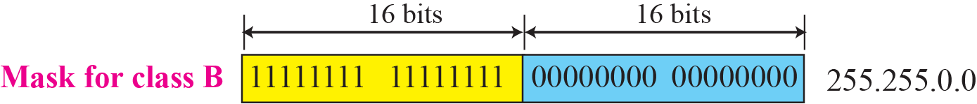
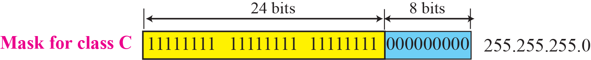
Figure 5.21 Network mask - Finding Network id Address
A network mask or a default mask in classful addressing is a
32-bit number with n leftmost bits all set to 1s and (32 - n) rightmost bits all set to 0s.
Notes:
Network Mask is Found by setting all NetId bits to 1’s and all hosted bits to 0’s in the corresponding class address.
A network mask or a default mask in classful addressing is a
32-bit number with n leftmost bits all set to 1s and (32 − n) rightmost bits all set to 0s.

Slide 55
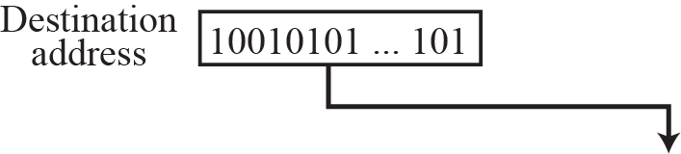
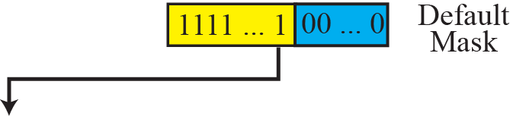
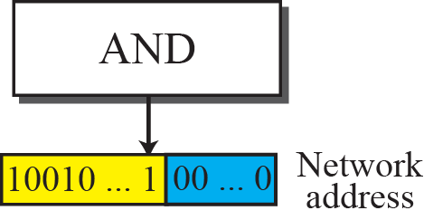
Figure 5.22 Finding a network address using the default mask
USE of Network Mask
Given an address & mask (or prefix length), we can find-
1st address (network address) & Last Address of the block to which given address belongs. Refer slide-Extracting Block Information(86-88)
Notes:
USE of Network Mask - To find Network Address
Given an address & mask (or prefix length), we can find 1st address & Last Address of the block to which given address belongs

Slide 56
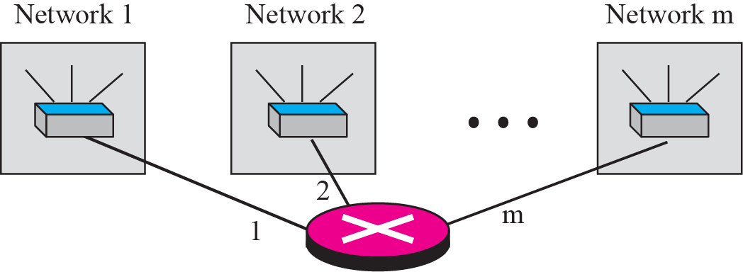
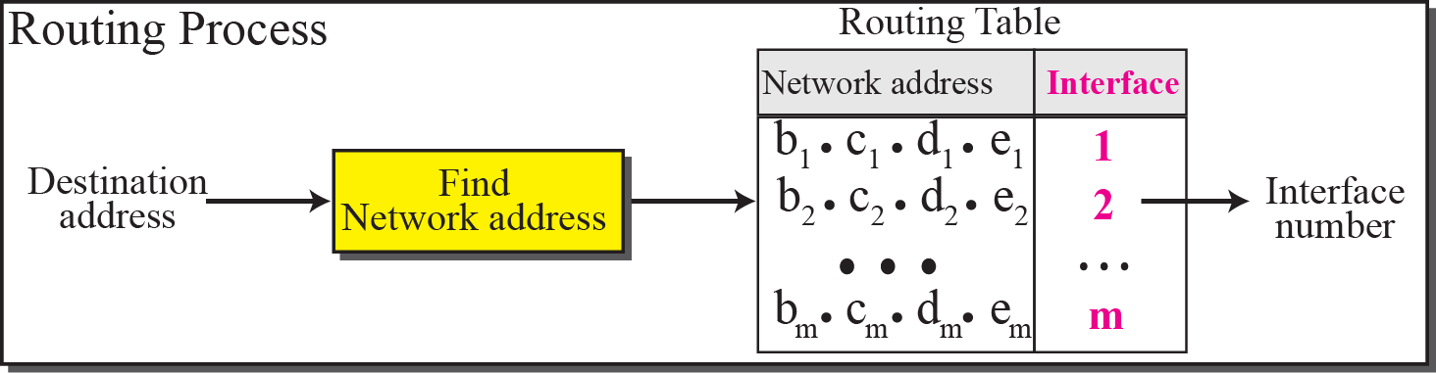
Figure 5.20 Network addresses
The network address is the identifier of a network.
Router consults Routing Table and decides through which interface of the Router the packet needs to be forwarded to reach a network identified by the netid.( network Address in the destination IP)
Notes:
Using Network Address to Route
Let us assume that an internet is made of m networks and a router with m interfaces. When a packet with some IP arrives at
the router from any source host, the router needs to know to which network the packet.
should be sent; the router needs to know from which interface the packet should be sent
out. So it is necessary to know network-address corresponding to IP. After the network
address has been found, the router consults its routing table to find the corresponding
interface from which the packet should be sent out. The network address is actually the
identifier of the network; each network is identified by its network address.
See Figure 6.9, chapter 6 DELIVERY AND FORWARDING OF IP PACKETS-page 167 for entries in routing Table
Default Gateway Basics
The default gateway is where your computer sends traffic to if it doesn’t know where the destination IP address. The default gateway is always a router.
When a computer tries to communicate with another computer on the same network it sends the data directly to it. If it is on a separate network it forwards the data to whatever IP address is specified in the default gateway. This is because it doesn’t know of this other network and it needs to send the data to a gateway out of it’s own network . This is why you always put the IP address of the router in the default gateway field. Because a router will be attached to multiple networks it knows where these other networks are so it can route traffic to them

Slide 57
Example 5.16
A router receives a packet with the destination address 201.24.67.32. Show how the router finds the network address of the packet.
Solution
Since the class of the address is C, we assume that the router applies the default mask for class C, 255.255 255.0 to find the network address.
Perform, Destination IP AND Default Mask(corresponding class of IP)
201. 24. 67. 32
AND 255.255.255. 0
==============
201. 24. 67. 0
Network address of the network(1st address in the network)
201. 24. 67. 0

Slide 58
SUBNETTING AND
SUPERNETTING
In the previous sections we discussed the problems associated with classful addressing. Specifically, the network addresses available for assignment to organizations are close to depletion. This is coupled with the ever-increasing demand for addresses from organizations that want connection to the Internet. In this section we briefly discuss two solutions: subnetting and supernetting.
The topics discussed in this section include:
Subnetting
Supernetting
Supernet Mask
Obsolescence

Slide 59
Note:
IP addresses are designed with two levels of hierarchy- Netid & Hostid
Notes:
The IP addresses were originally designed with two levels of
addressing. To reach a host on the Internet, we must first reach the network and then the
host.

Slide 60
Three-Level Addressing: Subnetting
The idea of splitting an address block into smaller blocks is referred to as subnetting.
In subnetting, a network is divided into several smaller subnetworks (subnets) with each subnetwork having its own sub-network address.
Why?
for better security and traffic management.
Notes:
for better security and management.
an organization that has been granted a block in class A or B could divide the block into smaller sub blocks and share them with other Organizations.
One goal of a subnet is to split a large network into a grouping of smaller, interconnected networks to help minimize traffic. This way, traffic doesn't have to flow through unnecessary routs, increasing network speeds.

Slide 61
Example 5.17
Three-level addressing can be found in the telephone system if we think about the local part of a telephone number as an exchange and a subscriber connection:
in which 626 is country code, 358 is the STD code, and 1301 is the subscriber connection.
Analogy to the Subnetting-3 Level hierarchy
Notes:
Analogy to the Subnetting-3 Level hierarchy

Slide 62
Example 5.18
Figure 5.23 (next slide) shows a network using class B addresses(141.14.0.0) before subnetting.
We have just one network with almost 2¹⁶ hosts.
The whole network is connected, through one single connection, to one of the routers in the Internet.
Note that we have shown /16 to show the length of the netid (class B).

Slide 63
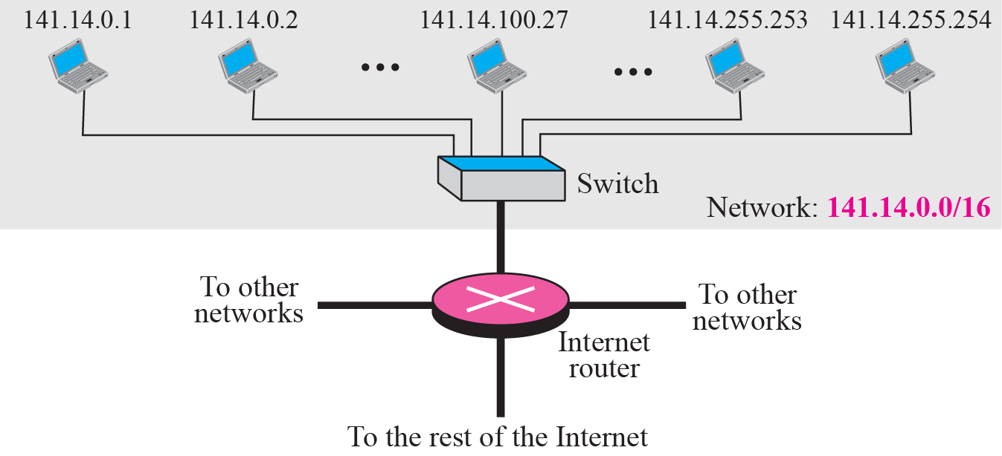
Figure 5.23 Example 5.18
Uses class B , Number of hosts = 2¹⁶⁼ = 65536
Notes:
Example 5.19
Figure 5.24 (slide 59)shows the same network in Figure 5.23(above) after subnetting. The whole network is still
connected to the Internet through the same router. However, the network has used a private router
to divide the network into four subnetworks. The rest of the Internet still sees only one network;
internally the network is made of four subnetworks. Each subnetwork can now have almost 2¹⁴
hosts. The network can belong to a university campus with four different schools (buildings).
After subnetting, each school has its own subnetworks, but still the whole campus is one network
for the rest of the Internet.
Why Subnet?
For networks with low intra-network bandwidth, subdividing a network ensures that only traffic destined for a particular computer in a subnet travels over that subnet's network. This keeps network congestion in other parts of the network down. This particular benefit only applies if you have a large network with limited bandwidth between computers.
One way to create different subnets is to connect each sub network to a different router and require all messages for a particular computer to pass through that router. This effectively isolates the subnets, allowing you to make "guest" and "trusted" divisions among your networked computers.
Once you've divided a network into subnets, you can assign each subnet to a different network administrator. This can be useful with large corporations; it keeps the logs separate and makes it easy to locate a particular computer by identifying its subnet first. In addition, subdividing a network by using routers enables you to send a "broadcast" message to only fellow members of a particular subnet. As an example, an engineering firm might have different subnets for the engineering and marketing department, and administrate both differently.

Slide 64
Example 5.19
Figure 5.24 shows the same network in Figure 5.23 after subnetting. The whole network is still connected to the Internet through the same router.
However, the network has used a private router to divide the network into four subnetworks.
The rest of the Internet still sees only one network; internally the network is made of four subnetworks.
Each subnetwork can now have almost 2¹⁴ hosts.
The network can belong to a university campus with four different schools (buildings).
Example: After subnetting, each school has its own subnetworks, but still the whole campus is one network for the rest of the Internet.
Note that /16 and /18 show the length of the netid and subnetids.
Notes:
Note that /16 and /18 show the length of the netid and subnets

Slide 65
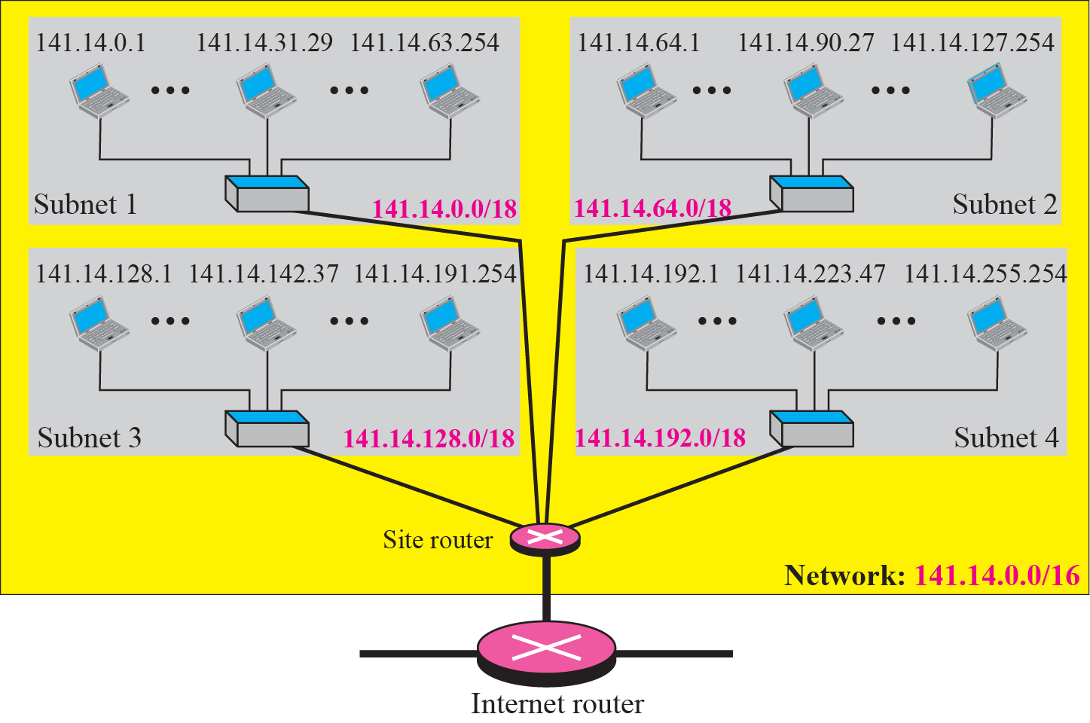
Figure 5.24 Example 5.19
How to do?
Notes:
Further 4 addresses needed to the ports of site router which are connecting to each subnet.
How to do?

Slide 66
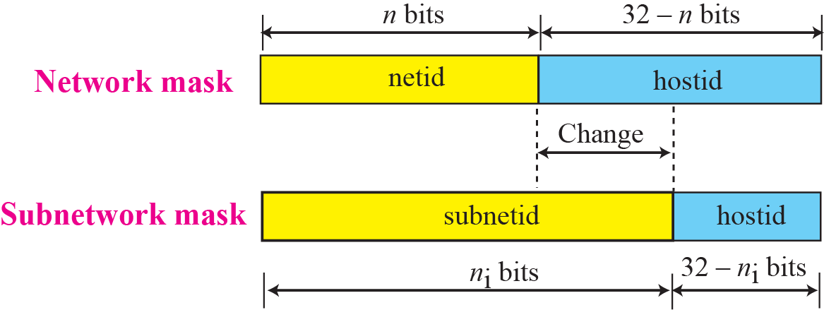
Figure 5.25 Network mask and subnetwork mask
141. 14. 0. 0
If ‘x’ bits are used then 2^{x} Subnets
Number of Subnets we can create depends on how many bits we take from hostid (32-n).
Assume that, we have an address Block 141.14.0.0 to 141.14.255.255
We can see, how 2 or 4 subnets can be created by claiming(changing) 1 or 2 bits in 3rd Byte(left most bit from Host ID) from right
Notes:
Number of Subnets we can create depends on how many bits we take from hostid
Assume that, we have an address Block 141.14.0.0 to 141.14.255.255
We can see, how 2 or 4 subnets can be created by claiming(changing) 1 or 2 bits from 3rd Byte(left most bit from Host ID) from right

Slide 67
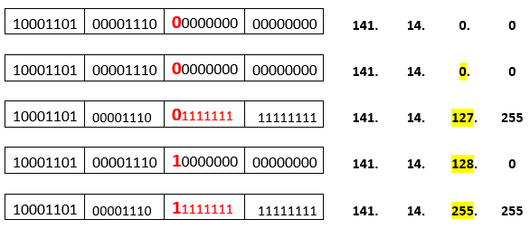
To create 2 subnets –
we have to use 1 rightmost bit of host id (right most 1 bit of 3rd Byte)
Given Network Address
Sub Net-1
1st Address
Last Address
Sub Net-2
1st Address
Last Address
Number of Host Addresses without subnet = 256*256 =65536
Number of Addresses in Subnet-1 =128*256 = 32768
Number of Addresses in Subnet-2 =128*256 = 32768
Notes:
To create 2 subnets – we have to use 1 rightmost bit of host id (right most 1 bit of 3rd Byte)
Network Address
Sub Net-1
Last Address
Number of Host Addresses without subnet = 256*256 =65536
Number of Addresses in Subnet-1 =128*256 = 32768
Number of Addresses in Subnet-2 =128*256 = 32768

Slide 68
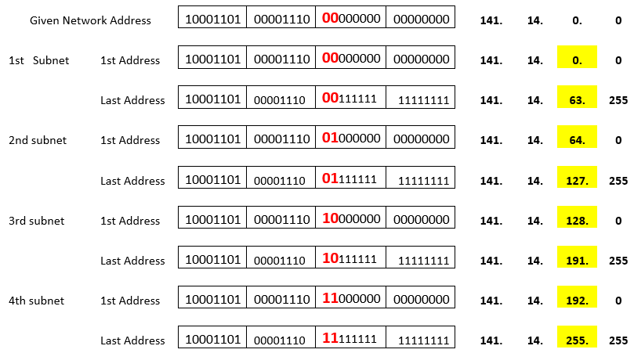
To Create 4 subnets-
We need 2 right most bits from 3rd byte of the given address (Class B, host id is 3rd & 4th Bytes)
See the addresses of Subnets created in the Previous slide
Notes:
To Create 4 subnets-
We need 2 right most bits from 3rd byte of the given address (Class B, host id is 3rd & 4th Bytes)
Same idea can be applied to view, how 4 subnets are created in the Previous slide

Slide 69
The Subnets looks as below-
How the packet is routed to a particular Subnet ?
In other words-
How site-router identifies each of subnets?
Notes:
The Subnets looks as below-
How the packet is routed to a particular Subnet ?

Slide 70
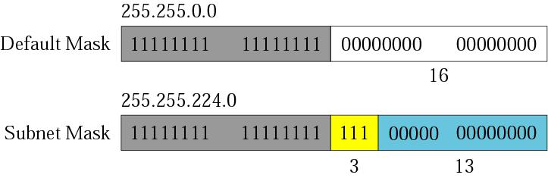
Comparison of a default mask and a subnet mask
After creating Subnets, what is the Mask for each subnet?
3 bits are used means 2³ = 8 Subnets can be created.
s- number of subnets and
Number of bits required = log₂^{s} = log₂⁸ = 3 bits
If Given Address Block is Class B (netid=n=16) , then
Total bits Required=n_{sub}=n+log₂^{s} =16+3 =19 bits for subnetid and 32 - 19=13 bits for hostid
Therefore subnet mask is- Nineteen 1^{s} & remaining Thirteen 0^{s}
11111111.11111111.11100000.00000000 255.255.224.0
Notes:
After creating Subnets, what is the Mask for the subnet?
3 bits are used means 2³ = 8 Subnets can be created
Subnetting increases the length of the netid and decreases the length of hostid.
When we divide a network to s number of subnetworks, each of equal numbers of
hosts, we can calculate the subnetid for each subnetwork as
n_{sub} = n + log₂^{s} Where n is the length of netid, n_{sub} is the length of each subnetid, and s is the number of subnets which must be a power of 2.

Slide 71
Subnet id length- n_{sub}
Subnetting increases the length of the netid and decreases the length of hostid.
When we divide a network to s number of subnetworks, each of equal numbers of hosts, we can calculate the subnetid for each subnetwork as -
n_{sub} = n + log₂^{s}
Where n is the length of netid,
n_{sub} is the length of each subnetid (net id of each subnet).
s is the number of subnets which must be a power of 2.
Notes:
Subnet id length

Slide 72
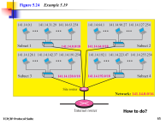
Example 5.20
Finding Subnet Mask
In Example 5.19, we divided a class B network into four subnetworks. The value of n = 16 and the value of
n₁ = n₂ = n₃ = n₄ = 16 + log₂4 =16+2= 18.
This means that the subnet mask has eighteen 1^{s} & fourteen 0^{s}.
11111111 11111111 11000000 00000000
In other words, the subnet mask is 255.255.192.0 which is different from the network mask for class B (255.255.0.0).
Notes:
Finding Subnet Mask

Slide 73
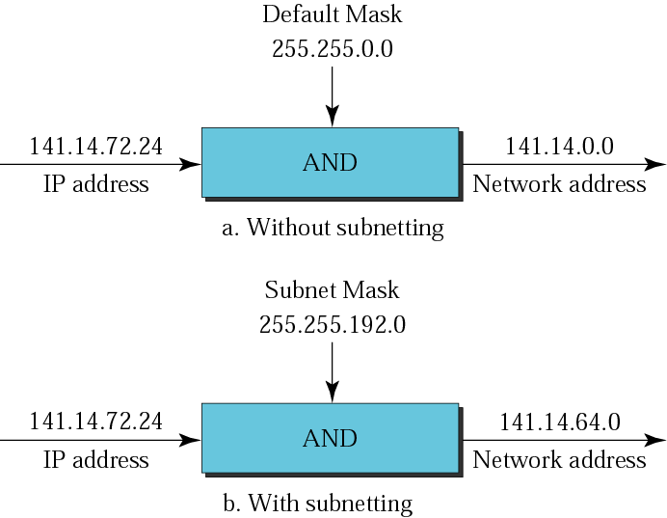
Finding Network Address
Default mask and Subnet Mask
1st Address in the Network- Network Address
1st Address in the Sub net-
Subnetwork Address
141.14.72.21/18 is a class B address –
its Default Mask 11111111 11111111 00000000 00000000 255.255.0.0
Since we are using 2 right most bits of 3rd Byte to create 4 subnets, the mask for each subnets is as below-
it is called as Subnet Mask
11111111 11111111 11000000 00000000 255.255192.0
Notes:
Finding Network Address
141.14.72.21 is a class B address – its Default Mask 11111111 11111111 00000000 00000000 255.255.0.0
ANY Address in the Block AND Default Mask = 1st Address of the Network.
Since we are using 2 right most bits of 3rd Byte to create 4 subnets, the mask for each subnets is as below-
it is called as subnet mask 11111111 11111111 11000000 00000000 255.255192.0
ANY Address in the SubNet AND Sub Net Mask = 1st Address of the Sub Network Address.

Slide 74
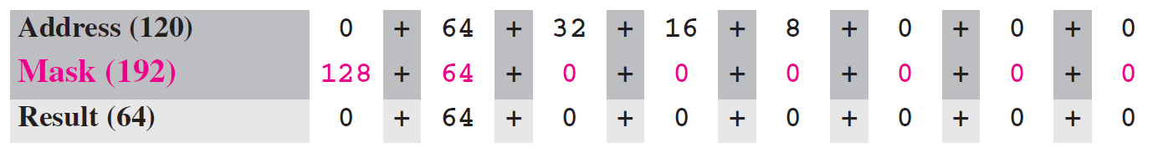
Example 5.21
In Example 5.19, we show that a network is divided into four subnets. Since one of the addresses in 2nd subnet is 141.14.120.77, we can find the subnet address as:
Shortcut to do AND
The values of the first, second, and fourth bytes are calculated using the first short cut for AND operation. The value of the third byte is calculated using the second short cut for the AND operation. (Refer Slide 17 &18) or use calculator to find AND
Notes:
Shortcut to do AND

Slide 75
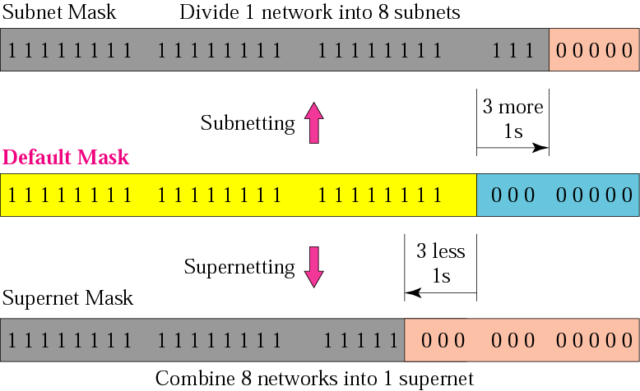
Comparison of subnet, default, and supernet masks

Slide 76
Note:
The idea of subnetting and supernetting of classful addresses is almost obsolete.

Slide 77
5-3 CLASSLESS ADDRESSING
Subnetting and supernetting in classful addressing did not really solve the address depletion problem. With the growth of the Internet, it was clear that a larger address space was needed as a long-term solution. Although the long-range solution has already been devised and is called IPv6, a short-term solution was also devised to use the same address space but to change the distribution of addresses to provide a fair share to each organization. The short-term solution still uses IPv4 addresses, but it is called classless addressing.

Slide 78
Topics Discussed in the Section
Variable –Length Blocks
Two-Level Addressing
Block Allocation
Subnetting

Slide 79
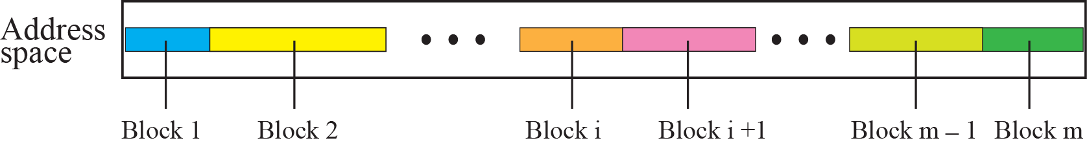
Figure 5.27 Variable-length blocks in classless addressing

Slide 80
Note
In classless addressing, the prefix defines the network and the suffix
defines the host.

Slide 81
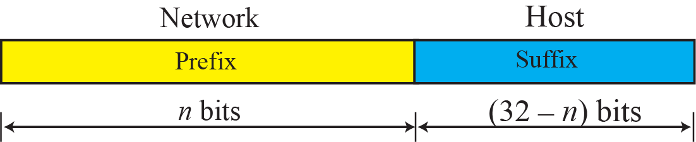
Figure 5.28 Prefix and suffix
prefix length –number of bits used to define prefix(network) i.e. n bits

Slide 82
Note
The prefix length in classless addressing can be 1 to 32.
Notes:
prefix length –number of bits used to define prefix(network)

Slide 83
Example 5.22
What is the prefix length and suffix length if the whole Internet(IPv6 addresses space) is considered as one single block with 4,294,967,296 addresses?
Solution
In this case, the prefix length is 0 and the suffix length is 32. All 32 bits vary to define 2³² = 4,294,967,296 hosts in this single block.

Slide 84
Example 5.23
What is the prefix length and suffix length if the Internet is divided into 4,294,967,296 blocks and each block has one single address?
Solution
In this case, the prefix length for each block is 32 and the suffix length is 0(zero). All 32 bits are needed to define 2³² = 4,294,967,296 blocks. The only address in each block is defined by the block itself.

Slide 85
Example 5.24
The number of addresses in a block is inversely related to the value of the prefix length, n.
A small n means a larger block; a large n means a small block.
n (prefix) small means 32-n (Suffix) is large and vice-versa
Notes:
n (prefix) small means 32-n (Suffix) is large and vice-versa

Slide 86
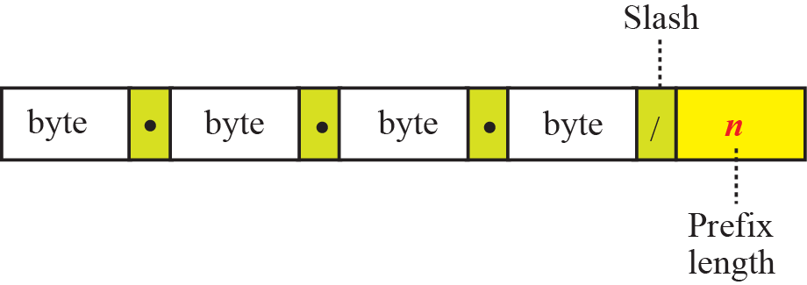
Figure 5.29 Slash notation
The slash notation is formally referred to as Classless InterDomain Routing or CIDR (pronounced cider) notation.
Network Mask
The idea of network mask in classless addressing is the same as the one in classful addressing. A network mask is a 32-bit number with the n leftmost bits all set to 1^{s} and the rest of the bits all set to 0^{s} (zeros).

Slide 87
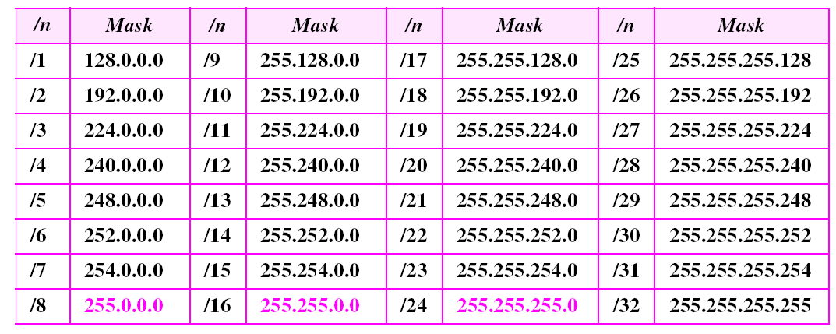
Prefix lengths

Slide 88
Note
In classless addressing, we need to know one of the addresses in the block
and the prefix length to define the block.

Slide 89
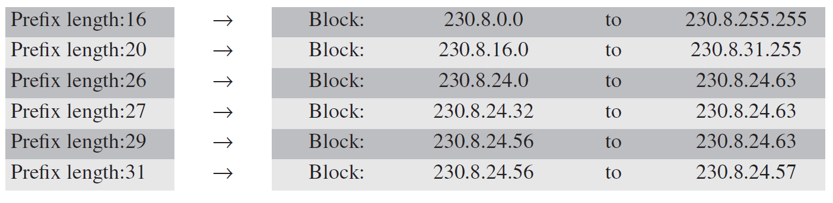
Example 5.25
In classless addressing, an address cannot per se define the block the address belongs to.
For example, the address 230.8.24.56 can belong to many blocks some of them are shown below with the value of the prefix associated with that block:
Notes:
Just by looking at any address, for example 230.8.24.56, it is not possible to tell block to which address belong. Above slide shows some of the blocks to which the address 230.8.24.56 may belong. Specifically you can say address belongs to a block only specifying prefix length along with address.
That is 230.8.24.56/26 means the 230.8.24.56 address belongs to 3rd block 230.8.24.0/26 to 230.8.24.63/26.
Similarly others.
Prefix Netmask(default or subnet) 1st Address Last address Block
16 255.255.0.0 230.8.24.56 AND 255.255.0.0 = 230.8.0.0 230.8.24.56 OR [NOT(255.255.0.0 )] 230.8.0.0 to
230.8.24.56 OR 0.0.255.255 =230.8.255.255 230.8.255.255
20 255.255.240.0 230.8.24.56 AND 255.255.240.0=230.8.16.0 230.8.24.56 OR[NOT(255.255.240.0)] 230.8.16.0 to
230.8.24.56 OR 0.0.15.255 = 230.8.31.255 230.8.31.255
26 255.255.255.192 230.8.24.56 AND 255.255.255.192=230.8.24.0 230.8.24.56 OR [NOT(255.255.255.192)] 230.8.24.56 to =230.8.24.63 230.8.24.63
Similarly for prefix
27
29
31

Slide 90
Extracting Block Information
An address in slash notation (CIDR) contains all information we need about the block: (this method can be applied to classful address also, because classful is a special case of classless where prefix length is fixed as /8,/16,/24)
The number of addresses in the block .
The first address (network address) in the block.
The last address of the Block.
These three pieces of information can be found as follows:
Notes:
Classful address scheme is a special case of classless address scheme where prefix length is fixed as 8 for Class A, 16 for Class B , 24 for Class C. 4 for Class D and 4 for Class E

Slide 91
Extracting Block Information
1. The number of addresses in the block.
The number of addresses in the block can be found as:
N=2^{32-n}
in which n is the prefix length and
N is the number of addresses in the block.
Example: If a given address is 167.199.170.82/27
n=27 , therefore number of addresses =2 ³²⁻²⁷=2⁵= 32
Similarly, if given address is 167.199.170.82 (no Prefix length)
Since prefix length is not given , let us assume as classful(special case of classless) address. The address is class B address , therefore Prefix length(netid)=16
Number of addresses= 2³²⁻¹⁶ =2¹⁶=65536
Notes:
Example: If a given address is 167.199.170.82/27
n=27 , 2 ³²⁻²⁷=32

Slide 92
Extracting Block Information
The first address (network address) in the block.
The first address (network address) in the block can be found by ANDing (Slide 17,18) the given address with the network mask:
Alternatively, we can keep the n leftmost bits of any address in the block and set the 32- n bits to 0^{s} to find the first address.
First address = (Any address in the Block) AND (network mask)

Slide 93
Extracting Block Information
The last address of the Block.
The last address in the block can be found by either adding the first address with the number of addresses (256 base number system Arithmetic) or, directly, by ORing (slide 19,20) the address with the complement
(NOTing) of the network mask:
Last address =
(any address in the block) OR [NOT (network mask)]

Slide 94
Example 5.26
The following addresses are defined using slash notations.
a. In the address 12.23.24.78/8, the network mask is 255.0.0.0. The mask has eight 1^{s} and twenty-four 0^{s}. The prefix length is 8; the suffix length is 24.
b. In the address 130.11.232.156/16, the network mask is 255.255.0.0. The mask has sixteen 1^{s} and sixteen 0^{s}.The prefix length is 16; the suffix length is 16.
c. In the address 167.199.170.82/27, the network mask is 255.255.255.224. The mask has twenty-seven 1^{s} and five 0^{s}. The prefix length is 27; the suffix length is 5.

Slide 95
Example 5.27
One of the addresses in a block is 167.199.170.82/27. Find the number of addresses in the network, the first address, and the last address.
Solution
The value of n is 27. The network mask has twenty-seven 1^{s} and five 0^{s} (Zeros). It is 255.255.255.224.
a. The number of addresses in the network is 2^{32 − n} = 32.
b. We use the AND operation to find the first address (network-address).The first address is 167.199.170.64/27.
167.199.170.82 AND 255.255.255.224 = 167.199.170.64

Slide 96
Example 5.27 Continued
c. To find the last address, we first find the complement of the network mask and then OR it with the given address: (how to Perform OR slide 19 & 20)
The last address is 167.199.170.95/27.
167.199.170.82 OR NOT ( 255.255.255.224) =
167.199.170. 82 if we use 256 base addition
OR 0. 0. 0. 31 Starting address +(32-1)addresses
==================== 167.199.170.64 + 0.0.0.31=167.199.170.95
167.199.170. 95
(refer notes section for 82 OR 15 or slide 19,20)
Notes:
82 written using Binary positional values
2⁷ 2⁶ 2⁵ 2⁴ 2³ 2² 2¹ 2⁰
82 =0+64+0+16+0+0+2+ 0
15= 0+ 0+ 0+ 0+ 8+4+2+ 1
====================
0+64+0+16+8+4+2+1 = 95 (select the larger term in each pair (or one of them if equal) and add them )

Slide 97
Example 5.28
One of the addresses in a block is 17.63.110.114/24.
Find the number of addresses, the first address, and the last address in the block.
Solution
The network mask is 255.255.255.0.
a. The number of addresses in the network is 2³² ⁻ ²⁴ = 256.
b. To find the first address, we use the short cut methods discussed early in the chapter. The first address is 17.63.110.0/24.

Slide 98
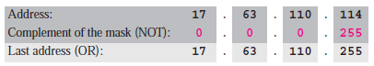
Example 5.28 Continued
c. To find the last address, we use the complement of the network mask and the first short cut method we discussed before.
The last address is 17.63.110.255/24.

Slide 99
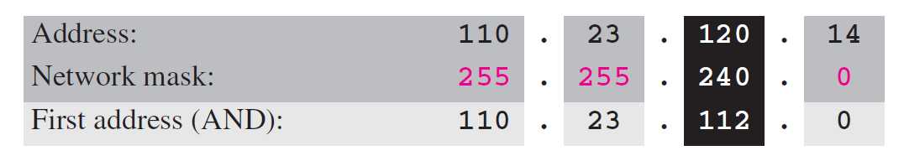
Example 5.29
One of the addresses in a block is 110.23.120.14/20.
Find the number of addresses, the first address, and the last address in the block.
Solution
The network mask is 255.255.240.0.
The number of addresses in the network is
2³² ⁻ ²⁰ = 4096.
b. To find the first address, we apply the first short cut to bytes 1, 2, and 4 and the second short cut to byte 3. The first address is 110.23.112.0/20.

Slide 100

Example 5.29 Continued
c. To find the last address, we apply the first short cut to bytes 1, 2, and 4 and the second short cut to byte 3 (slide 19 &20).
The OR operation is applied to the complement of the mask.
The last address is 110.23.127.255/20.
Notes:
if we use 256 base addition 4096 means we have add 4096-1=4095
110. 23.112. 0 (1st Address) 4095₍₁₀₎ = 15.255₍₂₅₆₎
+ 0. 0. 15. 255
==============
110.23.127.255

Slide 101
Another Method
Using 256 number system Addition
Slide 93- 96
Notes:
Another Method

Slide 102
Example 5
What is the first, Last address and number of addresses in the block if one of the addresses is 140.120.84.24/20?
Solution The first, second, and fourth bytes are easy; for the third byte we keep the bits corresponding to the number of 1s in that group.
The given is 140.120.84.24/20.
140. 120. 84. 24‭
10001100‬ ‭01111000‬ ‭01010100‬ ‭ 00011000‬
Notes:
Starting Address
10001100‬ ‭01111000‬ ‭01010000 ‭ 00000000
140.120.80.0
Last Address
10001100‬ ‭01111000‬ ‭01011111‬ ‭11111111
140.120.95.255

Slide 103
…Example 5
1st Address - 20 Bits ( prefix as it is) and suffix(12 bits) all 0^{’s}
140. 120 80 0
10001100‬ ‭01111000‬ ‭01010000‬ ‭00000000‬ 140.120.80.0/20
Last Address - 20 Bits ( prefix as it is) and suffix(12 bits) all 1^{’s}
‭ 140. 120 95 255
10001100‬ ‭01111000‬ ‭01011111 ‭11111111‬ 40.120.95.255/20

Slide 104
…Example 5
Number of addresses in the block if one of the addresses is 140.120.84.24/20.
Solution The prefix length is 20. The number of addresses in the block is 2³²⁻²⁰ or 2¹² or 4096. Note that this is a large block with 4096 addresses.

Slide 105
Example 8
Find the last address in the block if one of the addresses is 140.120.84.24/20.
Solution We found in the previous examples that the first address is 140.120.80.0/20 and the number of addresses is 4096.
To find the last address, we need to add 4095 (4096 − 1) to the first address.
See Next Slide

Slide 106
Example 8 (Continued)
To keep the format in dotted-decimal notation, we need to represent 4095 in base 256, and do the calculation in base 256. We write 4095 as 15.255. We then add the first address to this number (in base 256) to obtain the last address as shown below:
140 . 120 . 80 . 0 + 15 . 255 ------------------------- 140 . 120 . 95 . 255
The last address is 140.120.95.255/20.
Notes:
/20 means mask is - 255.255.240.0
Convert 4095₁₀ convert to 256 base (dividing 4095 by 256 and keeping track of remainder & writing in reverse order)
256 | 4095
|15 : 255
15.255 =>256 base back to Decimal 15*256¹ + 255 *256⁰ =4095

Slide 107
Example 10
Find the block if one of the addresses is 190.87.140.202/29.
Solution We follow the procedure in the previous examples to find the first address, the number of addresses, and the last address. To find the first address, we notice that the mask (/29) has five 1s in the last byte. So we write the last byte as powers of 2 and retain only the leftmost five as shown below:
See Next Slide

Slide 108
The mask (/29) has five 1’s and Three 0’s in the last byte.
The number of addresses is 2³²⁻²⁹ or 8.
Network mask is – 255.255.255.248
The first address is 190.87.140.200/29
The complement of 255.255.255.248 is 0.0.0.7.
If we OR this to the first address, we get 190.87.140.207/29.
In other words, the first address is 190.87.140.200/29, the last address is 190.87.140.207/29.
There are only 8 addresses in this block.

Slide 109
Example 11
Show a network configuration for the block in the previous example.
Solution The organization that is granted the block in the previous example can assign the addresses in the block to the hosts in its network. However, the first address needs to be used as the network address and the last address is kept as a special address (limited broadcast address). Figure in the next slide shows how the block can be used by an organization.
See Next Slide

Slide 110

Example 11

Slide 111
Note:
In classless addressing, the last address in the block does not necessarily end in 255.

Slide 112
Block Allocation
The ultimate responsibility of block allocation is given to a global authority called the Internet Corporation for Assigned Names and Addresses (ICANN).
For the proper operation of the CIDR, three restrictions need to be applied to the allocated block.
1. The number of requested addresses, N, needs to be a power of 2.
This is needed to provide an integer value for the prefix length, n (see the second restriction). The number of addresses can be 1, 2, 4, 8, 16, and so on.
2. The value of prefix length (n) can be found from the number of addresses in the block. Since N = 2³² ^{− n}, then n = log2 (2³²/N) = 32 - log₂N. That is the reason why N needs to be a power of 2.
3. The requested block needs to be allocated where there are a contiguous number of unallocated addresses in the address space. However, there is a restriction on choosing the beginning addresses of the block. The beginning address needs to be divisible by the number of addresses in the block.
Notes:
CIDR- Classless Inter-domain Routing.
n – prefix length
No of bits for suffix(for hosts)= 32-n
N=2³² ^{– n}
N= 2³² / 2^{n}
2^{n} =2³² /N Take log on both side n = log2 (2³²/N) = 32 - log₂N
Assume - log₂N =x
N =2^{x} where x may be 0,1,2,3,4,5 Therefore N will be always Power of 2
Assume starting address -18.14.12.80/28 & number of addresses required say 8
80= 01010000
18.14.12. 01010000 means 18.14.12. 80 divisible by 8 because we need minimum last 3 bits (i.e in 80) must be 000
18.14.12. 01010001 means 18.14.12. 81 Not divisible by 8 because last 3 bits (i.e in 81) are 001
18.14.12. 01010010 18.14.12. 82 ‘’ 010
18.14.12. 01010011 18.14.12. 83 ‘’ 011
18.14.12. 01010100 18.14.12. 84 ‘’ 100
18.14.12. 01010101 18.14.12. 85 ‘’ 101
18.14.12. 01010110 18.14.12. 86 ‘’ 110
18.14.12. 01010111 18.14.12. 87 ‘’ 111
18.14.12. 01011000 18.14.12. 88 divisible by 8 because we need minimum last 3 bits (i.e in 88) must be 000
18.14.12. 01011001 18.14.12. 89 Not divisible by 8 because last 3 bits (i.e in 81) are 001 ‘’
18.14.12. 01011010 18.14.12. 90 ‘’ 010
18.14.12. 01011011 18.14.12. 91 ‘’ 011
18.14.12. 01011100 18.14.12. 92 ‘’ 100
18.14.12. 01011101 18.14.12. 93 ‘’ 101
18.14.12. 01011110 18.14.12. 94 ‘’ 110
18.14.12. 01011111 18.14.12. 95 ‘’ 110

Slide 113
Example 1
Which of the following can be the beginning address of a block that contains 16 addresses?
a. 205.16.37.32 b.190.16.42.44 c. 17.17.33.80 d.123.45.24.52
Solution Only two are eligible (a and c). The address 205.16.37.32 is eligible because 32 is divisible by 16. The address 17.17.33.80 is eligible because 80 is divisible by 16.

Slide 114
Example 2
Which of the following can be the beginning address of a block that contains 256 addresses?
a.205.16.37.32 b.190.16.42.0 c.17.17.32.0 d.123.45.24.52
Solution In this case, the right-most byte must be 0. As we know, the IP addresses use base 256 arithmetic. When the right-most byte is 0(zero), the total address is always divisible by 256. Only two addresses are eligible (b and c).
Notes:
256-1=255₁₀ =0.255₂₅₆

Slide 115
Example 3
Which of the following can be the beginning address of a block that contains 1024(Note: more than 256) addresses?
205.16.37.32 b. 190.16.42.0
c. 17.17.32.0 d. 123.45.24.52
Solution In this case, we need to check two bytes because 1024=4 X 256. The right-most byte must be divisible by 256. The second byte (from the right) must be divisible by 4. Only one address is eligible (c).
Notes:
If Number of addresses Required are More than 256.
1024 addresses means last number corresponding to 1024th is 1024-1=1023
Convert 1023 to 256 base

Slide 116
Example 5.30
An ISP has requested a block of 1000 addresses. The block 18.14.12.0/22 is granted.
How many addresses ICANN allot.
Find prefix length, mask.
Which addresses can be a 1st , last address of the allotted block.
Notes:
If beginning address chosen is 18.14.12.0/22 ,we have check is it divisible by number of addresses.
18*256^3 +14*256^2+12*256^1+0*256^0 =302910464 (decimal value of address 18.14.12.0 which is a 256 base number system)
302910464 is completely divisible by total addresses 1024. Therefore 18.14.12.0/22 can be taken as 1st address.
/22 means n/w mask is 255.255.252.0 NOT of mask is 0.0.3.255
Last address=
18.14.12.0
OR 0.0.3.255
================
Last address 18.14.15.255 18.14.12.0/22 to 18.14.15.255 /22 can be allocated.
Same thing derived by 256 base addition.
i.e. 1024 means 4 * 256 = means 0.0.4.255
18.14.12.0
+ 0.0.4.255
If take an example block 200.100.14.0/23 can’t be allocated to give 1024 addresses
200*256^3 +100*256^2+14*256^1+0*256^0 =3362000384
3362000384 is not completely divisible by 1024, therefore 200.100.14.0 starting address can’t be used to allocate 1024 addresses.
If you take 200.100.12.0 can be used to allocate 1024 addresses because 200.100.12.0/22 is divisible by 1024.
200*256^3 +100*256^2+12*256^1+0*256^0 =3361999872
3361999872 is completely divisible by 1024.
/22 means n/w mask is 255.255.252.0 not of mask is 0.0.3.255
Last address=
200.100.12.0
OR 0.0.3.255
================
Last address 200.100.15.255 200.100.12.0/22 to 200.100.15.255 /22 can be allocated.
Whatever block satisfying restrictions may be allocated.
Similarll

Slide 117
Example 5.30
a. Since 1000 is not a power of 2, 1024 addresses are granted (1024 = 2¹⁰). Suffix length=N=10
b. The prefix length for the block is calculated as
n = 32 − log₂¹⁰²⁴ = 22.
Network Mask is 255.255.252.0
c. The beginning address is chosen as 18.14.12.0 (which
is divisible by 1024₍₁₀₎=4 X 256
The granted block is 18.14.12.0/22. The first address is 18.14.12.0/22 and the last address is 18.14.15.255/22.
Notes:
If beginning address chosen is 18.14.12.0/22 ,we have check is it divisible by number of addresses.
18*256^3 +14*256^2+12*256^1+0*256^0 =302910464 (decimal value of address 18.14.12.0 which is a 256 base number system)
302910464 is completely divisible by total addresses 1024. Therefore 18.14.12.0/22 can be taken as 1st address.
/22 means n/w mask is 255.255.252.0 NOT of mask is 0.0.3.255
Last address=
18.14.12.0
OR 0.0.3.255
================
Last address 18.14.15.255 18.14.12.0/22 to 18.14.15.255 /22 can be allocated.
Same thing derived by 256 base addition.
i.e. 1024 means 4 * 256 = means 0.0.4.255
18.14.12.0
+ 0.0.4.255
If take an example block 200.100.14.0/23 can’t be allocated to give 1024 addresses
200*256^3 +100*256^2+14*256^1+0*256^0 =3362000384
3362000384 is not completely divisible by 1024, therefore 200.100.14.0 starting address can’t be used to allocate 1024 addresses.
If you take 200.100.12.0 can be used to allocate 1024 addresses because 200.100.12.0/22 is divisible by 1024.
200*256^3 +100*256^2+12*256^1+0*256^0 =3361999872
3361999872 is completely divisible by 1024.
/22 means n/w mask is 255.255.252.0 not of mask is 0.0.3.255
Last address=
200.100.12.0
OR 0.0.3.255
================
Last address 200.100.15.255 200.100.12.0/22 to 200.100.15.255 /22 can be allocated.
Whatever block satisfying restrictions may be allocated.
Similarll

Slide 118

Classful address - Special case of classless address
Classful address scheme is a special case of classless address scheme where prefix length is fixed as 8 for Class A, 16 for Class B , 24 for Class C. 4 for Class D and 4 for Class E
Notes:
Classful address is a special case of classless address scheme where prefix length is fixed as 8 for Class A, 16 for Class B and 24 for Class C.

Slide 119
Example 5.31
Assume an organization has given a class A block as 73.0.0.0 in the past. If the block is not revoked by the authority, the classless architecture assumes that the organization has a block 73.0.0.0/8 in classless addressing.

Slide 120
Note
The restrictions applied in allocating addresses for a subnetwork are
parallel to the ones used to allocate addresses for a network.

Slide 121
Designing Subnets
The sub networks in a network should be carefully designed to enable the routing of packets. We assume the total number of addresses granted to the organization is N, the prefix length is n, the assigned number of addresses to each sub network is Nsub, the prefix length for each sub network is nsub, and the total number of sub networks is s. Then, the following steps need to be carefully followed to guarantee the proper operation of the sub networks.
1. The number of addresses in each sub network should be a power of 2.
2. The prefix length for each sub network should be found using the following formula:
3. The starting address in each subnetwork should be divisible by the number of addresses in that subnetwork. This can be achieved if we first assign addresses to larger networks.
Notes:
N-Total number of addresses in the granted block
N_{sub} - Number of addresses required in the subnet (has to be power of 2).
n- Prefix length of granted address block
log₂(N/N_{sub}) - Gives Extra bits (apart from n bits) needed to create subnet.

Slide 122
N-Total number of addresses in the granted block
N_{sub} - Number of addresses required in the subnet (has to be power of 2).
n- Prefix length of granted address block
log₂(N/N_{sub}) - Gives Extra bits (apart from n bits) needed to create subnet.
Just compare with subnetting in Classful
n_{sub} = n + log₂^{s}
Where n is the length of netid,
n_{sub} is the length of each subnetid (net id of each subnet).
s is the number of subnets which must be a power of 2.
Each subnet has equal no of addresses =
Total No of Addr in Block/No of Subnets

Slide 123
Example 5.32
An organization is granted the block 130.34.12.64/26. The organization needs four subnetworks, each with an equal number of hosts. Design the subnetworks and find the information about each network.
Solution
The number of addresses for the whole network can be found as N = 2⁽ ³² ⁻ ²⁶ ⁾ = 64. The first address in the network is 130.34.12.64/26 and the last address is 130.34.12.127/26. We now design the sub networks:
1. We grant 16 addresses for each sub network to meet the first requirement (16 is a power of 2).
2. The subnetwork mask for each subnetwork is:
Notes:
/28 means subnet mask 255.255.255.240

Slide 124
Example 5.32 Continued
3. We grant 16 addresses to each subnet starting from the first available address. Figure 5.32 shows the sub-block for each subnet.
Note that the starting address in each subnetwork is divisible by the number of addresses in that subnetwork.
/28 means subnet mask 255.255.255.240
1st address in 1st subnet
130.34.12.64 AND 255.255.255.240 = 130.34.12.64/28 ,
check is it divisible by 16 (Yes 64/16)
Last address in 1st subnet,
130.34.12.64 OR (NOT [ 255.255.255.240 ] ) =130.34.12.79/28
Notes:
/28 means subnet mask 255.255.255.240
1st add in 1st subnet 130.34.12.64 AND 255.255.255.240 = 130.34.12.64 , check is it divisible by 16 , 16₍₁₀₎ = 0.0.0.16₍₂₅₆₎
Last 130.34.12.64 OR (NOT[ 255.255.255.240 ]) =130.34.12.79
2nd Subnet starts from say 130.34.12.80 , can be given only if divisible by 16 , yes can be given.
Similarly all other

Slide 125


Figure 5.30 Solution to Example 5.32
Similarly Block information about other Subnets can be found.
Notes:
130.34.12.64 divisible by 16 & last address =>130.34.12.64 +0.0.0.15 =130.34.12.79 Method - 130.34.12.64 OR (NOT[ 255.255.255.240 ]) =130.34.12.79
130.34.12.80 divisible by 16 & last address =>130.34.12.80 +0.0.0.15 =130.34.12.95
130.34.12.96 divisible by 16 & last address =>130.34.12.96 +0.0.0.15 =130.34.12.111
130.34.12.112 divisible by 16 & last address =>130.34.12.112 +0.0.0.15 =130.34.12.127
Similarly Block information about other Subnets can be found

Slide 126
Example 5.33
An organization is granted a block of addresses with the beginning address 14.24.74.0/24. The organization needs to have 3 subblocks of addresses to use in its three subnets as shown below:
❑ One subblock of 120 addresses.
❑ One subblock of 60 addresses.
❑ One subblock of 10 addresses.
Solution
There are 2³² ⁻ ²⁴ = 256 addresses in this block. The first
address is 14.24.74.0/24; the last address is 14.24.74.255/24.
The number of addresses in the first subblock is not a power of 2. We allocate 128(=2⁷) addresses. The prefix length is 25 (see Notes section) . 14.24.74.0 divisible by 128
The first address is 14.24.74.0/25; the last address is 14.24.74.127/25 (see Notes section).
Notes:
n_{sub}= n +log₂(N/N_{sub})
N-Total number of addresses in the granted block =256
N_{sub} - Number of addresses required in the subnet (has to be power of 2). =128
n- Prefix length of granted address block =24
log₂(N/N_{sub}) - Gives Extra bits (apart from n bits) needed to create subnet. Log₂(256/128) =. Log₂2 =1
n_{sub} - Total bits required to create subnet
n_{sub} = n + log₂(N/N_{sub}) = 24+1 =25
b. 1st address 14.24.74.0 is divisible by number of addresses(i.e. 128) Yes. (because 128₍₁₀₎ =0.0.0.128₍₂₅₆₎ 4th octet 0 in 14.24.74.0 is divisible by 128 ,74 divisible by 0, 24 divisible by 0 and 14 is divisible by 0)
since n_{sub} =25 , subnet mask is (rightmost 25 bits set 1^{s} and remaining 7 bits to 0^{s}) 11111111 11111111 11111111 10000000 => 255 255 255 127
Last address => 14.24.74.0 OR ( NOT (255.255.255.127) )
14.24.74.0 OR 0.0.0.127 = 14.24.74.127
Last address 14.24.74.127
‭00001110‬ ‭00011000‬ ‭01001010‬ 00000000

Slide 127
Example 5.33 Continued
b. The number of addresses in the second subblock is not a power of 2 either. We allocate 64 addresses. The subnet length is 26. 1st address 14.24.74.128 divisible by 64.
The first address in this block is 14.24.74.128/26; the
last address is 14.24.74.191/26.
c. The number of addresses in the third subblock is not a power of 2 either. We allocate 16 addresses. The subnet mask is 28. The first address in this block is 14.24.74.192/28
( Divisible by 16); the last address is 14.24.74.207/28.
d. If we add all addresses in the previous subblocks, the result is 208 addresses, which means 48 addresses are left in reserve. The first address in this range is 14.24.74.209. The last address is 14.24.74.255.
e. Figure 5.31 shows the configuration of blocks. We have shown the first address in each block.

Slide 128


Figure 5.31 Solution to Example 5.33
Solve the same problem by allocating addresses in the order 64, 16 & 120 addresses.
Notes:
Try solving same problem, but allocate addresses in the order 64,16 &120 addresses.

Slide 129
Example 5.34
Assume a company has three offices: Central, East, and West. The Central office is connected to the East and West offices via private WAN lines.
The company is granted a block of 64 addresses with the beginning address 70.12.100.128/26, Last address 70.12.100.191/26 .
The management has decided to allocate 32(power of 2) addresses for the Central office and divides the rest of addresses equally between the two other offices.
1. The number of addresses are assigned as follows:
2. We can find the prefix length for each subnetwork:
Notes:
beginning address 70.12.100.128/26 and number of addresses 64 ,means add(256 base) 63 (Block Address- 70.12.100.128 to 70.12.100.191)
70.12.100.128
+ 0. 0 .0 .63
===========
70.12.100.191 (Last Address)
Another Method –
/26 means mask is 255.255.255.192
Not (255.255.255.192)=0.0.0.63
70.12.100.128
OR 0. 0 .0 .63
===========
70.12.100.191 (Last Address)

Slide 130
Example 5.34 Continued
3. Figure 5.32 shows the configuration designed by the management. The Central office uses addresses 70.12.100.128/27 ( Divisible by 32 ) to 70.12.100.159/27. The company has used three of these addresses for the routers and has reserved the last address in the sunblock. The East office uses the addresses 70.12.100.160/28 ( Divisible by 16) to 70.12.100.175/28. One of these addresses is used for the router and the company has reserved the last address in the sub block. The West office uses the addresses 70.12.100.176/28 to 70.12.100.191/28. One of these addresses is used for the router and the company has reserved the last address in the sub block. The company uses no address for the point-to-point connections in WANs.

Slide 131

Figure 5.32 Example 5.34
West
70.12.100.176/28
To
70.12.100.191/28
Central office
70.12.100.128/27
To
70.12.100.159/27
East
70.12.100.160/28
To
70.12.100.175/28

Slide 132
Example 5.35
An ISP is granted a block of addresses starting with 190.100.0.0/16 (65,536 addresses). The ISP needs to distribute these addresses to three groups of customers as follows:
❑ The first group has 64 customers; each needs approximately 256 addresses.
❑ The second group has 128 customers; each needs approximately 128 addresses.
❑ The third group has 128 customers; each needs approximately 64 addresses.
We design the subblocks and find out how many addresses are still available after these allocations.

Slide 133
Example 5.35 Continued
Solution
Let us solve the problem in two steps.
In the first step, we allocate a subblock of addresses to each group. The total number of addresses allocated to each group and the prefix length for each subblock can found as
Figure 5.33 shows the design for the first hierarchical level. Figure 5.34 shows the second level of the hierarchy. Note that we have used the first address for each customer as the subnet address and have reserved the last address as a special address.
Notes:
Group 1
Mask 255.255.192.0
Complement of Mask 0. 0. 63.255
Last address 190.100.0.0
OR 0.0.63.255
==================
190.100. 63.255
Group 2
Next address is 190.100.64.0, it can be 1st address of Group 2, if and is divisible by number of addresses - 16384
n=18 ,
Mask 255.255.192.0
Complement of Mask 0. 0. 63.255
Last address 190.100.64.0
OR 0.0.63.255
==================
190.100.127.255
Group 3
Next address is 190.100.128.0, it can be 1st address of Group 3, if and is divisible by number of addresses - 8192
n=19 ,
Mask 255.255.224.0
Complement of Mask 0. 0. 31.255
Last address 190.100.128.0
OR 0.0.31.255
==================
190.100.159.255

Slide 134
Group 1
1st Address 190.100.0.0/18
Divisible by 64 X 256
n=18 Mask 255.255.192.0
Complement of Mask 0. 0. 63.255
Last address 190.100.0.0
OR 0.0.63.255
==================
190.100. 63.255/18
Group 2
Next address is 190.100.64.0/18, it can be 1st address of Group 2, if and is divisible by number of addresses – 16384 (i.e 64 X 256)
n=18 ,
Mask 255.255.192.0
Complement of Mask 0. 0. 63.255
Last address 190.100.64.0
OR 0.0.63.255
==================
190.100.127.255/18
Group 3
Next address is 190.100.128.0/19, it can be 1st address of Group 3, if and is divisible by number of addresses – 8192 (i.e. 32 X 256)
n =19,
Mask 255.255.224.0
Complement of Mask 0. 0. 31.255
Last address 190.100.128.0
OR 0.0.31.255
=================
190.100.159.255/19
Notes:
128 = ‭10000000‬
OR 31 = 00011111‬
===========
10011111 =159
Following Method (Refer slide19,20)
128 = 128+0+0+ 0+ 0+0+0+0
OR 31 = 0 +0+0+16+8+4+2+1
=============================
128+0+0+16+8+4+2+1 =159 128 OR 31 =159

Slide 135

Figure 5.33 Solution to Example 5.35: first step

Slide 136



Figure 5.34 Solution to Example 5.35: second step
Notes:
Customer 001 with 256 addresses
Starting address 190.100.0.0/24 ,ALSO DIVISIBLE BY 256
24 means mask is 255.255.255.0 ,its complement 0.0.0.255
190.100.0.0
OR 0 .0 .0. 255
=============
190.100.0.255
190.100.0.0/24 TO 190.100.0.255/24 for Customer 001
Next address for Customer 002 is 190.100.1.0/24 , also divisible by 256
190.100.1.0
OR 0. 0. 0. 255
==========
190.100.1.255
Like this if we proceed takes long to get Beginning address and end address of last Customer 064
WE can just add (63*256 =16128) 16128-1=16127 address to staring address of block to get end address of 63rd Customer.
16127 we can convert to 256 base number 62. 255 and add it to 190.100.0.0/24
190. 100. 0. 0
+ 0. 0. 62.255
==============
190.100.62.255/24
63rd customer has last address in his block (63rd block) is 190.100.62.255/24
Next address 190.100.63.0/24 can be starting address to 64th Customer(256 addresses).
190.100.63.0/24 is divisible by 256, YES .
/24 means , mask is 255.255.255.0 and complement is 0.0.0.255
190.100.63.0
OR 0. 0. 0.255
==============
190.100.63.255
Last 64th Customer has block - 190.100.63.0/24 to 190.100.63.255/24

Slide 137
5-4 SPECIAL ADDRESSES
In classful addressing some addresses were reserved for special purposes. The classless addressing scheme inherits some of these special addresses from classful addressing.

Slide 138
Topics Discussed in the Section
Special Blocks
Special Addresses in each Block

Slide 139

Figure 5.35 Example of using the all-zero address
The block 0.0.0.0/32, which contains only one single address
Normally used by a host A as the Source IP during bootstrap time when it does not know its own IPv4 address
Notes:
Some blocks of addresses are reserved for special purposes.
All-Zeros Address
The block 0.0.0.0/32, which contains only one single address, is reserved for communication
when a host needs to send an IPv4 packet but it does not know its own address.
This is normally used by a host at bootstrap time when it does not know its IPv4 address.
The host sends an IPv4 packet to a bootstrap server (called DHCP server as discussed in
Chapter 18) using this address as the source address and a limited broadcast address as
the destination address to find its own address .

Slide 140
Figure 5.36 Example of limited broadcast address
A host that wants to send a message to every other host inside the same network can use this address as a destination address in an IPv4 packet. However, a router will block a packet bearing this as destination address.
Notes:
All-Ones Address: Limited Broadcast Address
The block 255.255.255.255/32, which contains one single address, is reserved for limited
broadcast address in the current network. A host that wants to send a message to every
other host can use this address as a destination address in an IPv4 packet. However, a
router will block a packet having this type of address to confine the broadcasting to the
local network. In Figure 5.36, a host sends a datagram using a destination IPv4 address
consisting of all 1s. All devices on this network receive and process this datagram.
Limited broadcast is the broadcast limited to a single LAN and which is to be received by all. It is sent to reserved Class E , IP address 255.255.255.255. The destination MAC address for such frames will be FF:FF:FF:FF:FF:FF. The router simply drop the Limited broadcast address and does not forward it.

Slide 141

Example of loopback address
As an example, the loopback address can be used by a client process (a running application program) to send a message to a server process on the same machine.
Notes:
Loopback Addresses
The block 127.0.0.0/8 is used for the loopback address, which is an address used to test
the software on a machine. When this address is used, a packet never leaves the
machine; it simply returns to the protocol software. It can be used to test the IPv4 software.
For example, an application such as “ping” can send a packet with a loopback
address as the destination address to see if the IPv4 software is capable of receiving and
processing a packet. As another example, the loopback address can be used by a client
process (a running application program) to send a message to a server process on the
same machine. Note that this can be used only as a destination address in an IPv4
packet

Slide 142
Figure 5.37 Example of loopback address
loopback address, which is an address used to test the software on a machine
Notes:
Loopback Addresses
The block 127.0.0.0/8 is used for the loopback address, which is an address used to test
the software on a machine. When this address is used, a packet never leaves the
machine; it simply returns to the protocol software. It can be used to test the IPv4 software.
For example, an application such as “ping” can send a packet with a loopback
address as the destination address to see if the IPv4 software is capable of receiving and
processing a packet. As another example, the loopback address can be used by a client
process (a running application program) to send a message to a server process on the
same machine. Note that this can be used only as a destination address in an IPv4
Packet.
Like any other packets traversing the TCP/IP stack, looped-back packets convey the IP address and port number they were addressed to. Thus, the services that ultimately receive them can respond according to the specified loopback destination. For example, an HTTP service could route packets addressed to 127.0.0.99:80 and 127.0.0.100:80 to different Web servers, or to a single server that would return different web pages. To simplify such testing, the hosts file can be modified to provide appropriate aliases for each such address.
In windows 10 C:\Windows\System32\drivers\etc folder contains different file such as Services (poet numbers), Host (host names and corresponding IP^{s} ,loopback), Protocol (protocol numbers).
Similarly in Linux /etc/hosts
The local loopback mechanism is useful for testing software during development, independently of any networking configurations. For example, if a computer has been configured to provide a website, directing a locally running web browser to http://localhost may display its home page
However, one special range of addresses is set aside for loopback functionality. This is the range 127.0.0.0 to 127.255.255.255. IP datagrams sent by a host to a 127.x.x.x loopback address are not passed down to the data link layer for transmission. Instead, they “loop back” to the source device at the IP level. In essence, this represents a “short-circuiting” of the normal protocol stack; data is sent by a device's layer three IP implementation and then immediately received by it. The purpose of the loopback range is testing of the TCP/IP protocol implementation on a host.

Slide 143

A number of blocks are assigned for private use. They are not recognized globally. These blocks are depicted in Table 5.2.
These addresses are used either in isolation or in connection with Network Address Translation (NAT) techniques

Slide 144
Multicast Addresses
The block 224.0.0.0/4 is reserved for multicast communication
Notes:
Multicast Addresses
The block 224.0.0.0/4 is reserved for multicast communication. We discuss multicasting
in Chapter 12 in detail
Special Addresses in Each block
It is not mandatory, but it is recommended, that some addresses in a block be used for
special addresses. These addresses are not assigned to any host. However, if a block (or subblock)is so small, we cannot afford to use part of the addresses as special addresses.
Network Address
We have already discussed network addresses. The first address (with the suffix set all to 0s) in a block defines the network address. It actually defines the network itself
(cabling) and not any host in the network. Of course, the first address in a subnetwork is called the subnetwork address and plays the same role.

Slide 145
Special Addresses in Each block
It is not mandatory, but it is recommended, that some addresses in a block be used for special addresses.
These addresses are not assigned to any host.
- Network Address
- Direct Broadcast

Slide 146

Network Address
The first address (with the suffix set all to 0s) in a block defines the network address. It actually defines the network itself (cabling) and not any host in the network. 1st address in a subnetwork is called the subnetwork address and plays the same role.
Network address

Slide 147
Figure 5.38 Example of a directed broadcast address
Last address in the block
Directed Broadcast address is the local subnet broadcast address
This address is usually used by a router to send a packet to
all hosts in a specific network
Notes:
Directed Broadcast address is the local subnet broadcast address. If the subnet is 192.168.10.0 , the directed broadcast address will be 192.168.10.255 , which will be heard by all in the same subnet hosts. The router will receive such packet and process it. The destination mac address will still be FF:FF:FF:FF:FF:FF, as it is to be received by all hosts. If a Device on some other network want to communicate with all devices in a network with address 192.168.10.0 then Destination address must be 192.168.10.255 DHCP packets are Limited broadcast packets and NBNS uses directed broadcast packets. NetBIOS Name Service (NBNS) This service is often called WINS on Windows systems. The NetBIOS Name Service is part of the NetBIOS-over-TCP protocol suite,
The last address in a block or subblock (with the suffix set all to 1s) can be used as a
direct broadcast address. This address is usually used by a router to send a packet to
all hosts in a specific network. All hosts will accept a packet having this type of destination
address. Note that this address can be used only as a destination address in an IPv4
packet. In Figure 5.38, the router sends a datagram using a destination IPv4 address
with a suffix of all 1s. All devices on this network receive and process the datagram.
Limited broadcast is the broadcast limited to a single LAN and which is to be received by all. It is sent to reserved Class E , IP address 255.255.255.255. The destination MAC address for such frames will be FF:FF:FF:FF:FF:FF. The router simply drop the Limited broadcast address and does not forward it.

Slide 148
Different types of Addresses
Communication on the Internet can be achieved using unicast, multicast or broad cast address.
Unicast communication is one to one: A packet is sent from one individual source to one individual destination.
Multicast is one to many: A packet is sent from an individual source to a group of destinations.
Class D address is a multicast address.
The entire address defines a group ID.
A system in the internet can have more the one multicast address.
Note: Class D address can be used as a Destination Address only.
Broadcast communication is one to all.
The internet allows broadcasting only in the local level and not in the global level. This means that a system can not send a message to all the hosts and the routers in the internet.
Two types of broad cast in local level are: The limited broadcast address and direct broadcast address.

Slide 149
NAT TCP/IP Protocol Suit Forouzan

Slide 150
5-5 NAT
The distribution of addresses through ISPs has created a new problem. If the business grows or the household needs a larger range, the ISP may not be able to grant the demand because the addresses before and after the range may have already been allocated to other networks. In most situations, however, only a portion of computers in a small network need access to the Internet simultaneously. A technology that can help in this cases is network address translation (NAT).

Slide 151
Topics Discussed in the Section
Address Translation
Translation Table

Slide 152

Figure 5.39 NAT
The rest of the Internet sees only the NAT router with the address 200.24.5.8
Notes:
A technology that can provide the mapping between the private and universal addresses, is network address translation (NAT). The technology allows a site to use a
set of private addresses for internal communication and a set of global Internet addresses. (at least one) for communication with the rest of the world. The site must have only one single connection to the global Internet through a NAT-capable router that runs NAT software. Figure 5.39 shows a simple implementation of NAT.
As the figure shows, the private network uses private addresses. The router that connects the network to the global address uses one private address and one global
address. The private network is transparent to the rest of the Internet; the rest of the Internet sees only the NAT router with the address 200.24.5.8.

Slide 153

Figure 5.40 Address resolution
Notes:
Address Translation
All of the outgoing packets go through the NAT router, which replaces the source
address in the packet with the global NAT address. All incoming packets also pass
through the NAT router, which replaces the destination address in the packet (the NAT
router global address) with the appropriate private address. Figure 5.40 shows an example
of address translation.
As the figure shows, the private network uses private addresses. The router that
connects the network to the global address uses one private address and one global
address. The private network is transparent to the rest of the Internet; the rest of the
Internet sees only the NAT router with the address 200.24.5.8.
Translation Table
The reader may have noticed that translating the source addresses for an outgoing
packet is straightforward. But how does the NAT router know the destination address
for a packet coming from the Internet? There may be tens or hundreds of private IP addresses,
each belonging to one specific host. The problem is solved if the NAT router
has a translation table.
In this strategy, communication must always be initiated by the private network.
The NAT mechanism described requires that the private network start the communication.
As we will see, NAT is used mostly by ISPs that assign one single address to a
customer. The customer, however, may be a member of a private network that has many
private addresses.
In this case, communication with the Internet is always initiated from
the customer site, using a client program such as HTTP, TELNET, or FTP to access the
corresponding server program.
A private network cannot run a server program for clients outside of its network if
it is using NAT technology.

Slide 154
Figure 5.41 Translation
#Communication must always be initiated by the
private network.
#A Private network cannot run a server program for
clients outside of its network if it is using NAT
technology.
Notes:
Translation Table
The reader may have noticed that translating the source addresses for an outgoing
packet is straightforward. But how does the NAT router know the destination address
for a packet coming from the Internet? There may be tens or hundreds of private IP addresses,
each belonging to one specific host. The problem is solved if the NAT router
has a translation table.
In this strategy, communication must always be initiated by the private network.
The NAT mechanism described requires that the private network start the communication.
As we will see, NAT is used mostly by ISPs that assign one single address to a
customer. The customer, however, may be a member of a private network that has many
private addresses.
In this case, communication with the Internet is always initiated from
the customer site, using a client program such as HTTP, TELNET, or FTP to access the
corresponding server program.
A private network cannot run a server program for clients outside of its network if
it is using NAT technology.

Slide 155
NAT Table with only IP addresses (1)
P1- Source address(private Address) , D1-Destination address, G1-Global IP
1 global address
1 private
P1 → D1
G1 → D1
NAT Table for G1
P1
D1
D1
D1 → P1
D1 → G1
different external hosts
1 global address
P1 → D1
NAT Table for G1
G1 → D1
2 privates
P2 → D2
P1
D1
G1 → D2
D1
P2
D2
D1 → P1
D1 → G1
D2
D2 → P2
D2 → G1
Notes:
P1- Source address(private Address) , D1-Destination address, G1-Global IP
Using One IP Address
In its simplest form, a translation table has only two columns: the private address and
the external address (destination address of the packet). When the router translates the
source address of the outgoing packet, it also makes note of the destination address—
where the packet is going. When the response comes back from the destination, the
router uses the source address of the packet (as the external address) to find the private
address of the packet. Figure 5.41 shows the idea.

Slide 156
NAT Table with only IP addresses (2)
Same external host
1 global address
P1 → D1
NAT Table for G1
G1 → D1
2 privates
P1
D1
P2 → D1
G1 → D1
P2
D1
D1
？？？
D1 → G1
？？？
D1 → G1
Same external host
2 global addresses
P1 → D1
NAT Table for G1
G1 → D1
D1 → P1
P1
D1
D1 → G1
2 privates
P2 → D1
NAT Table for G2
G2 → D1
D1
D1 → P2
P2
D1
D1 → G2
Notes:
Two different hosts with Private address P1 ,P2 communicating with same Destination host with Address-D1 and only one Global IP G1 is used.
Using a Pool of IP Addresses
Using only one global address by the NAT router allows only one private-network host to access the same external host. To remove this restriction, the NAT router can use a
pool of global addresses. For example, instead of using only one global address (200.24.5.8), the NAT router can use four addresses (200.24.5.8, 200.24.5.9,
200.24.5.10, and 200.24.5.11). In this case, four private-network hosts can communicate with the same external host at the same time because each pair of addresses defines
a connection. However, there are still some drawbacks. No more than four connections can be made to the same destination. No private-network host can access two external server programs (e.g., HTTP and TELNET) at the same time. And, likewise, two private-network hosts cannot access the same external server program (e.g., HTTP or
TELNET) at the same time.

Slide 157
NAT Table with only IP addresses (3)
If using only one global address
Only one private-network host to access the same external host
If using a pool of global addresses (e.g. 4 addr)
No more than 4 connections can be made to the same destination
Two private-network hosts cannot access the same external server program at the same time (by using the same global address)
Notes:
If a pool of Global IP (in above example 4 Global IP) used. In this case No more than 4 connections can be made to the same destination. (see fig in next slide)
Using a Pool of IP Addresses
Using only one global address by the NAT router allows only one private-network host
to access the same external host. To remove this restriction, the NAT router can use a
pool of global addresses. For example, instead of using only one global address
(200.24.5.8), the NAT router can use four addresses (200.24.5.8, 200.24.5.9,
200.24.5.10, and 200.24.5.11). In this case, four private-network hosts can communicate
with the same external host at the same time because each pair of addresses defines
a connection. However, there are still some drawbacks. No more than four connections
can be made to the same destination. No private-network host can access two external
server programs (e.g., HTTP and TELNET) at the same time. And, likewise, two
private-network hosts cannot access the same external server program (e.g., HTTP or
TELNET) at the same time.

Slide 158
NAT Table with IP address & Port # (4)
NAT Table in the textbook
This may not be the best way to understand NAT
Server
Must be unique
Otherwise reassign a new private port and cache the mapping (the new port --> the old port)
Notes:
Using Both IP Addresses and Port Addresses
To allow a many-to-many relationship between private-network hosts and external
server programs, we need more information in the translation table. For example, suppose
two hosts inside a private network with addresses 172.18.3.1 and 172.18.3.2 need
to access the HTTP server on external host 25.8.3.2. If the translation table has five
columns, instead of two, that include the source and destination port addresses and the
transport layer protocol, the ambiguity is eliminated. Table 5.3 shows an example of
Note that when the response from HTTP comes back, the combination of source
address (25.8.3.2) and destination port address (1400) defines the private network host
to which the response should be directed. Note also that for this translation to work, the
ephemeral port addresses (1400 and 1401) must be unique.

Slide 159
END of CHAPTER

